Slide 1
About the Course Software Testing & Verification
Course Software Testing & Verification
2024/25
Wishnu Prasetya & Gabriele Keller

Slide 2
Why do we care?
Because we want to deliver quality products!
Because poor quality, including software bugs, may have severe consequences
e.g. some errors in the software of UK Inland Revenue is rumored to cause tax-credit over-payment of 3.45 billions USD. (Charette, Why Software Fails. IEEE Spectrum, 2005)
Uber self-driving accident 2018

Slide 3
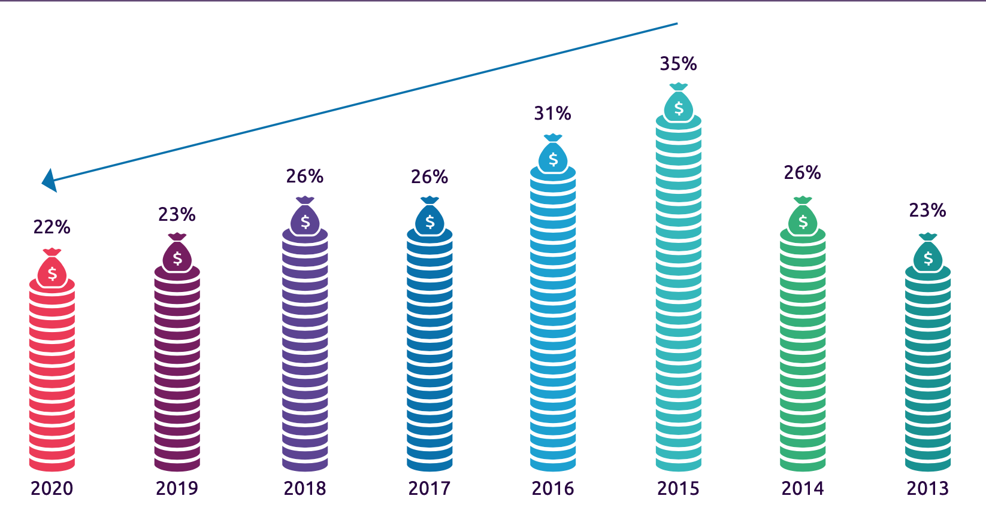
Invested effort in quality assurance (QA)
World Quality Report, 2020/21. 1750 mostly CIOs, 32 countries

Slide 4
The project management aspect of quality assurance is non-trivial
Requirement Analysis
Acceptance Test
Architecture Design
System Test
Detailed
Design
Integration Test
Implementation
Unit Test
By developers
A typical testing project approach called “V-model”

Slide 5
In this course we will focus on the technical foundation of software verification
How to specify what constitutes “correct” behavior?
How to verify the correctness of a program?
What constitute good tests ? When have we tested enough?
Can we automate these steps?
Notes:
Blue: in the scope
Gray: to some degree, optionally in the scope through optional parts in our project

Slide 6
(top level) Learning Goals
Know a selected set of basic concepts, theories, techniques, and technologies of Software Testing and Software Verification They represent two complementary approaches towards software correctness : pragmatism vs completeness.
Able to relate these theories and techniques to real problems.

Slide 7
Not in scope
Project management aspects of quality assurance (QA) in a large project → covered in Software Project (bachelor).
Automated verification algorithms → covered in the Program Semantic & Verification course (master).

Slide 8
Pre-requisite
C#
Working with IDE
The “software verification” part will go into the mathematical foundation of verification. You will need background in:
Set theory
Predicate logic

Slide 9
Site & Materials
ics.uu.nl/docs/vakken/b3stv
Paul Ammann and Jeff Offutt, Introduction to Software Testing, 1st edition, Cambridge University Press, Cambridge, UK, ISBN 0-52188-038-1, 2008. 2nd Ed is also ok, if you can’t get 1st anymore.
Lecture Notes (can be obtained from the website), for the program verification part.

Slide 10
Project & assignment
Software testing homework (3x).
Testing Project
Proving program correctness assignment (3x)

Slide 11
Grading
In total 9 components: testing homework (3), project, proof assignments (3), 2x exams.
Criteria to pass the course:
You do all exams and projects.
The average of your exams should be ≥ 5.0.
Your score (see below) should be ≥ 6
score = if 5.0 ≤ raw ≤ 6.0 then raw rounded to the closest int else raw rounded to the closest 0.1
raw = 0.05 * testing homework + 0.2 * proof assignments + 0.25 * testing project + 0.25 * exam-1 + 0,25 * exam-2 Your final score = “score” (above), except if you didn’t meet criteria 1 or 2 above; then your final score would either NVD or AANV.
Resit: only if you fail and (4.0 ≤ raw or final=AANV)

Slide 12
Use of AI (ChatGPT etc)
Using AI like ChatGPT for homeworks and proof assignments are not allowed (count as cheating).
Using CoPilot for your testing project is allowed (we just see it as another test generator).
Do not blindly trust CoPilot !
You have the end-responsibility (you can’t blame CoPilot if your solution doesn’t work).

Slide 13
Software
Jetbrains Raider IDE, you can get free education license. Works on Windows and Mac, supposedly also on Linux.
Or Visual Studio Enterprise edition. Not free.
Use Github to host your project. Please make your git-repository private!

Slide 14
Load
We have a pretty dense programme. Expect to commit at least 16hrs/week.
Suggested plan:
Lectures + lab/wekcollege sessions: 8h/w
Self-study the theory: 4h/w
Sprints for your Testing Project: 4h/w
Notes:
Total project hours available. Assuming 8 weeks
Team of 3: 8*3*4 = 96h
Team of 3: 64h
Assumption of Testing Project load: 80h (30h Iteration 1 and 50h Iteration 2)

Slide 15
Running the course
Overall week-to-week plan: see website
MS-Team B3STV, for:
Submitting Testing-homeworks and Proof-assignments.
Channels where you can pose questions.
Lectures and werkcolleges are physical (on-site) every Monday and Thursday. You have the TAs during the werkcolleges.
I will be monitoring Team-channels outside werkcollege hours.

Slide 16
Crew
Wishnu Prasetya (lectures, werkcollege, Team)
Gabriele Keller (lectures)
Quincy Einmahl (TA, werkcollege)
Charl-Pierre Marais (TA, werkcollege)
Ben Stokmans (TA, werkcollege)
Mitchel Zhu (TA, werkcollege)

