Slide 1
Computer Animation - Lecture 2
Interpolation & Blending
From Curves to State Machines: Core Techniques for Smooth Animation
Metehan Doyran
m.doyran@uu.nl

Slide 2
Reminders
Do you know your team members for the project and presentation?
Please fill in the project form.
Do you want to know the papers to review and what paper to present?
  The set of 28 papers
  Select 1 paper for presentation and fill in the presentation form
  Select also 6 papers (individually) that you want to read as we go (no need to tell the teachers in advance). You need to submit the paper review 1 day before the day paper is presented.
Deadline for the forms: 19 November Tuesday 23:59

Slide 3
Rendering the Recap:
What We Covered Previously
Foundations of Animation
  History
  Basics
Mathematical Underpinnings
  Linear Algebra (supplementary material)
  Forward Kinematics
  Orientation
Practical Applications
  Motion Capture Lab
Next up: How we achieve smooth and realistic animation!

Slide 4
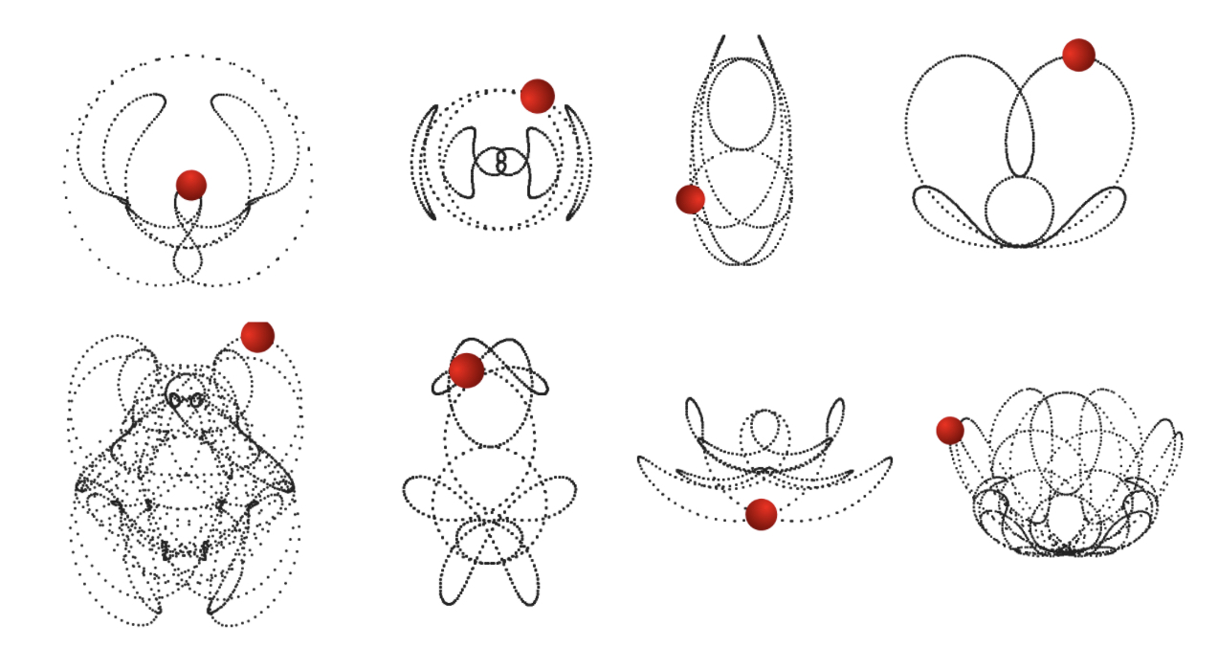
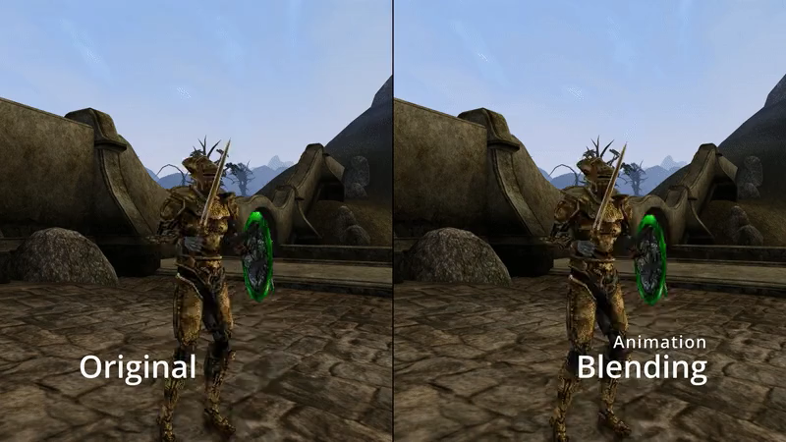
Today’s Roadmap
Interpolation Basics
  Cubic curves
  Keyframes & Channels
Advanced Techniques
  Blending
  Sequencing
Practical Applications
  Animation Playback
  Animation Blending
  Animation State Machines
Notes:
How we mathematically represent motion.
How to seamlessly combine and sequence animations
Bringing it all together in real-world scenarios
By the end of this lecture, you'll understand how these techniques create smooth, realistic animations

Slide 5
Cubic Curves
Notes:
Put an overview slide after this one to show two ways of defining cubic curves:
Bezier curve
Hermite curve

Slide 6
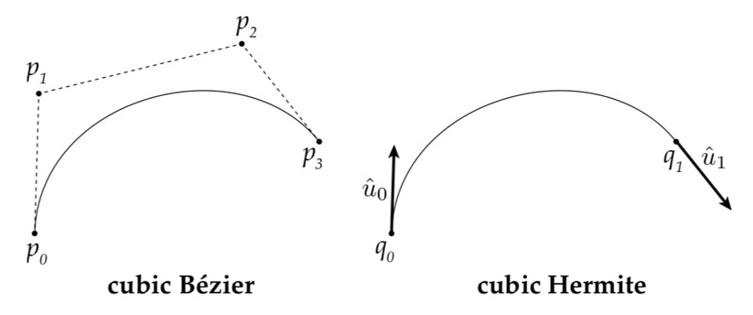
Cubic Curves
Notes:
Two ways of describing cubic curves, the names can be used interchangeably

Slide 7
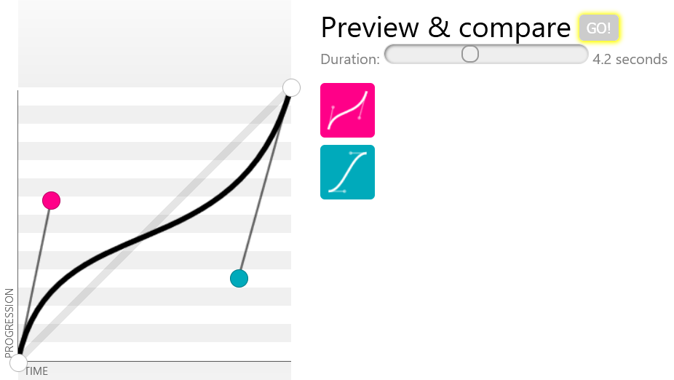
Bezier Curves
https://cubic-bezier.com
css-tricks.com/advanced-css-animation-using-cubic-bezier/
Notes:
Pierre Étienne Bézier (September 1, 1910 – November 25, 1999) was a French engineer and one of the founders of the fields of solid, geometric and physical modeling as well as in the field of representing curves, especially in CAD/CAM systems.^{[1]} As an engineer at Renault, he became a leader in the transformation of design and manufacturing, through mathematics and computing tools, into computer-aided design and three-dimensional modeling

Slide 8
Bezier Curves
Bezier curves can be thought of as a higher order extension of linear interpolation
p₁
p₁
p₂
p₃
p₁
p₀
p₀
p₀
p₂
Notes:
Pierre Étienne Bézier (September 1, 1910 – November 25, 1999) was a French engineer and one of the founders of the fields of solid, geometric and physical modeling as well as in the field of representing curves, especially in CAD/CAM systems.^{[1]} As an engineer at Renault, he became a leader in the transformation of design and manufacturing, through mathematics and computing tools, into computer-aided design and three-dimensional modeling

Slide 9
Bézier Curves: Formulations
De Casteljau Algorithm
Recursive and geometric. Intuitive for learning and debugging.
Bernstein Polynomials
Mathematical basis for control point influence.
Cubic Equations
Compact representation; efficient for evaluation.
Matrix form
Practical for animation and rendering.
Notes:
The Bernstein polynomials and de Casteljau's algorithm are two different approaches to defining and evaluating the same mathematical object - a Bézier curve.
Both methods will produce identical points on a Bézier curve given the same control points. They are mathematically equivalent, just expressed and computed differently.
The Bernstein polynomial form is actually the mathematical foundation for Bézier curves. De Casteljau's algorithm is derived from this foundation but presents a different way to compute points on the curve.
Bernstein polynomials give an explicit formula for the curve. De Casteljau's algorithm implicitly defines the curve through a recursive process.

Slide 10
Casteljau and Bézier
Historical Background
  Paul de Casteljau: Algorithm for recursive interpolation (1959).
  Pierre Bézier: Formalized and applied the curve in CAD (1960s).
Key Contributions
  Casteljau: Geometric, recursive construction.
  Bézier: Practical applications and popularization.
Connection
  De Casteljau’s algorithm forms the geometric basis for Bézier curves.
Notes:
Paul de Casteljau (born 1930 in Besançon, France.) is a French physicist and mathematician. In 1959, while working at Citroën, he developed an algorithm for evaluating calculations on a certain family of curves, which would later be formalized and popularized by engineer Pierre Bézier, and the curves called De Casteljau curve or Bézier curves.

Slide 11
Bezier Curve
Find the point x on the curve as a function of parameter t:
p₁
•
p₀
x(t)
p₂
p₃

Slide 12
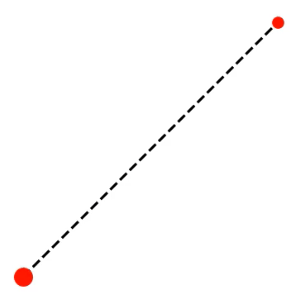
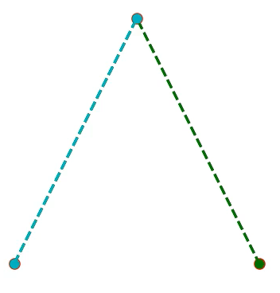
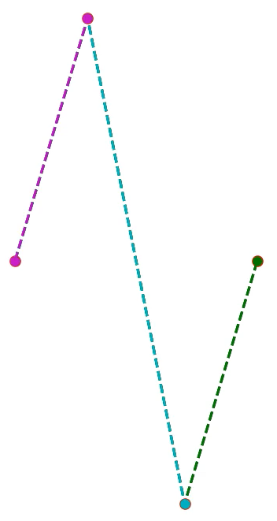
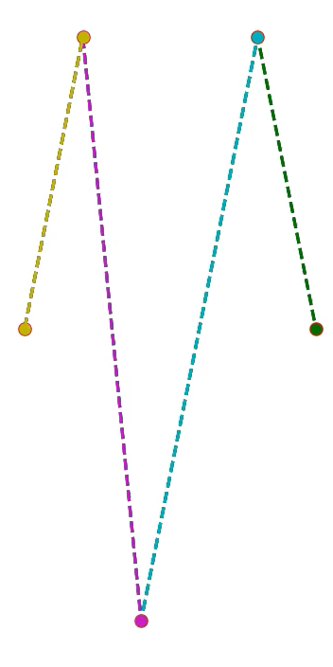
De Casteljau Algorithm
Describes the curve as a recursive series of linear interpolations
Linear
Quadratic
Cubic
Quartic

Slide 13
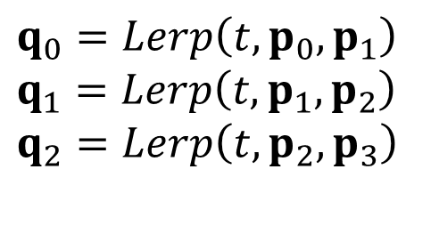
de Casteljau Algorithm
p₁
q₁
q₀
$$q_{0}=Lerp\left(t,p_{0},p_{1}\right) \\ q_{1}=Lerp\left(t,p_{1},p_{2}\right) \\ q_{2}=Lerp\left(t,p_{2},p_{3}\right)$$
p₀
p₂
q₂
p₃

Slide 14
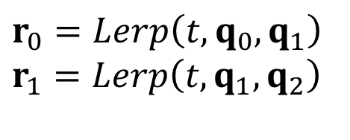
de Casteljau Algorithm
q₁
q₀
r₀
r₁
$$r_{0}=Lerp\left(t,q_{0},q_{1}\right) \\ r_{1}=Lerp\left(t,q_{1},q_{2}\right)$$
q₂

Slide 15

de Casteljau Algorithm
r₀
•
x
r₁
$$x=Lerp\left(t,r_{0},r_{1}\right)$$

Slide 16
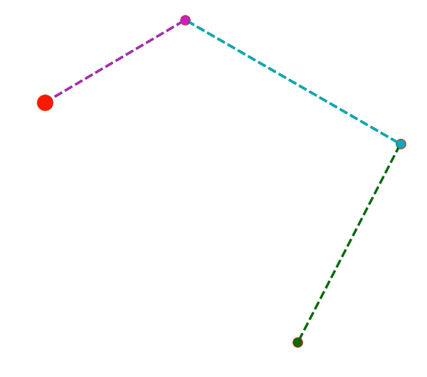
Bezier Curve
p₁
•
p₀
x
p₂
p₃

Slide 17
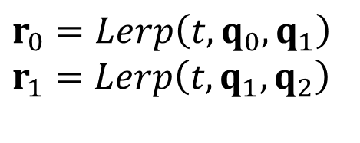
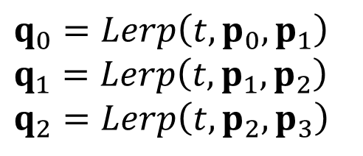



Recursive Linear Interpolation
$$p_{0} \\ p_{1} \\ p_{2} \\ p_{3}$$
$$q_{0}=Lerp\left(t,p_{0},p_{1}\right) \\ q_{1}=Lerp\left(t,p_{1},p_{2}\right) \\ q_{2}=Lerp\left(t,p_{2},p_{3}\right)$$
$$x=Lerp\left(t,r_{0},r_{1}\right)$$
$$r_{0}=Lerp\left(t,q_{0},q_{1}\right) \\ r_{1}=Lerp\left(t,q_{1},q_{2}\right)$$
$$Lerp\left(t,a,b\right)=\left(1−t\right)a+tb$$

Slide 18



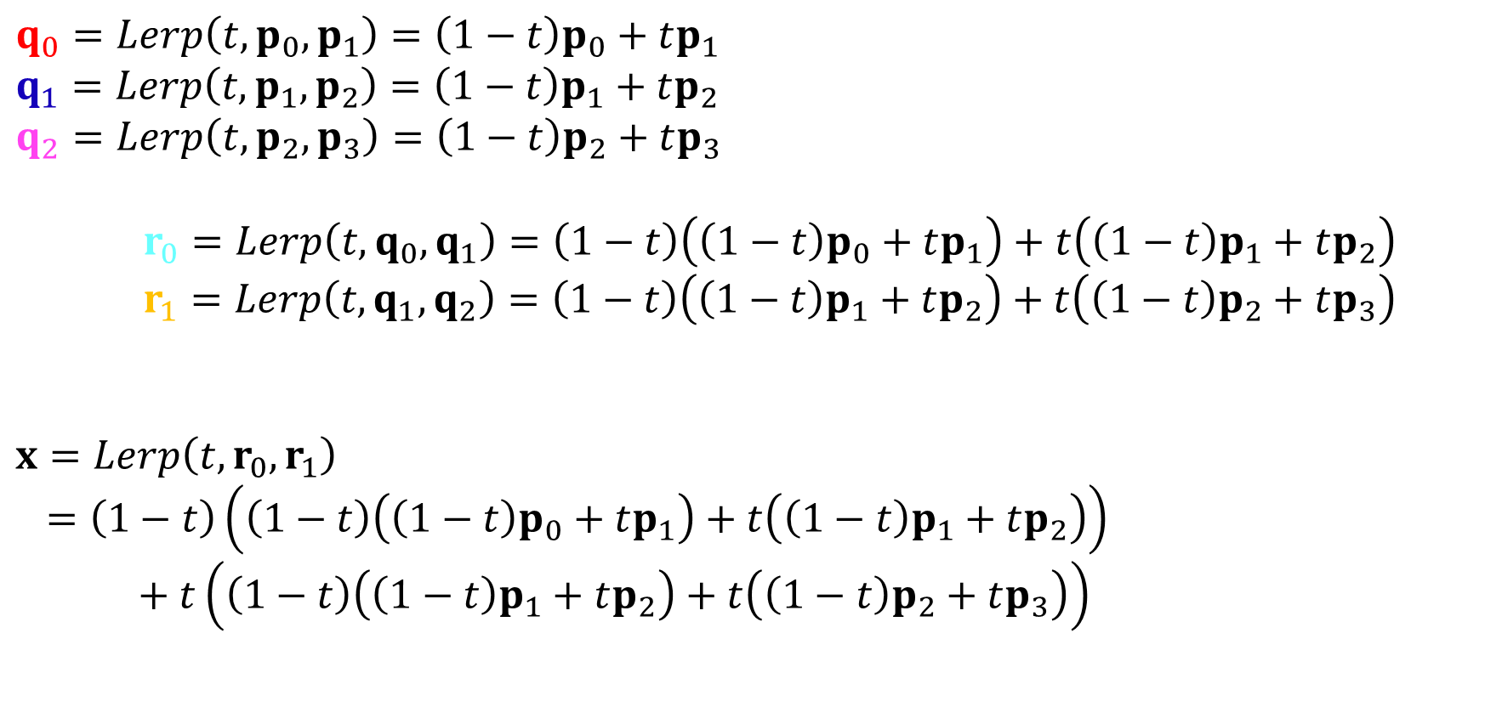



Expanding the Lerps
$$q_{0}=Lerp\left(t,p_{0},p_{1}\right)=\left(1−t\right)p_{0}+tp_{1} \\ q_{1}=Lerp\left(t,p_{1},p_{2}\right)=\left(1−t\right)p_{1}+tp_{2} \\ q_{2}=Lerp\left(t,p_{2},p_{3}\right)=\left(1−t\right)p_{2}+tp_{3}$$
$r_{0}=Lerp\left(t,q_{0},q_{1}\right)=\left(1−t\right)\left(\left(1−t\right)p_{0}+tp_{1}\right)+t\left(\left(1−t\right)p_{1}+tp_{2}\right)$
$r_{1}=Lerp\left(t,q_{1},q_{2}\right)=\left(1−t\right)\left(\left(1−t\right)p_{1}+tp_{2}\right)+t\left(\left(1−t\right)p_{2}+tp_{3}\right)$
$$x=Lerp\left(t,r_{0},r_{1}\right)$$
$=\left(1−t\right)\left(\left(1−t\right)\left(\left(1−t\right)p_{0}+tp_{1}\right)+t\left(\left(1−t\right)p_{1}+tp_{2}\right)\right)$
$$\begin{matrix} & & \end{matrix}+t\left(\left(1−t\right)\left(\left(1−t\right)p_{1}+tp_{2}\right)+t\left(\left(1−t\right)p_{2}+tp_{3}\right)\right)$$
$$q_{0}$$
$$q_{1}$$
$$q_{1}$$
$$q_{2}$$
$$r_{0}$$
$$r_{1}$$

Slide 19
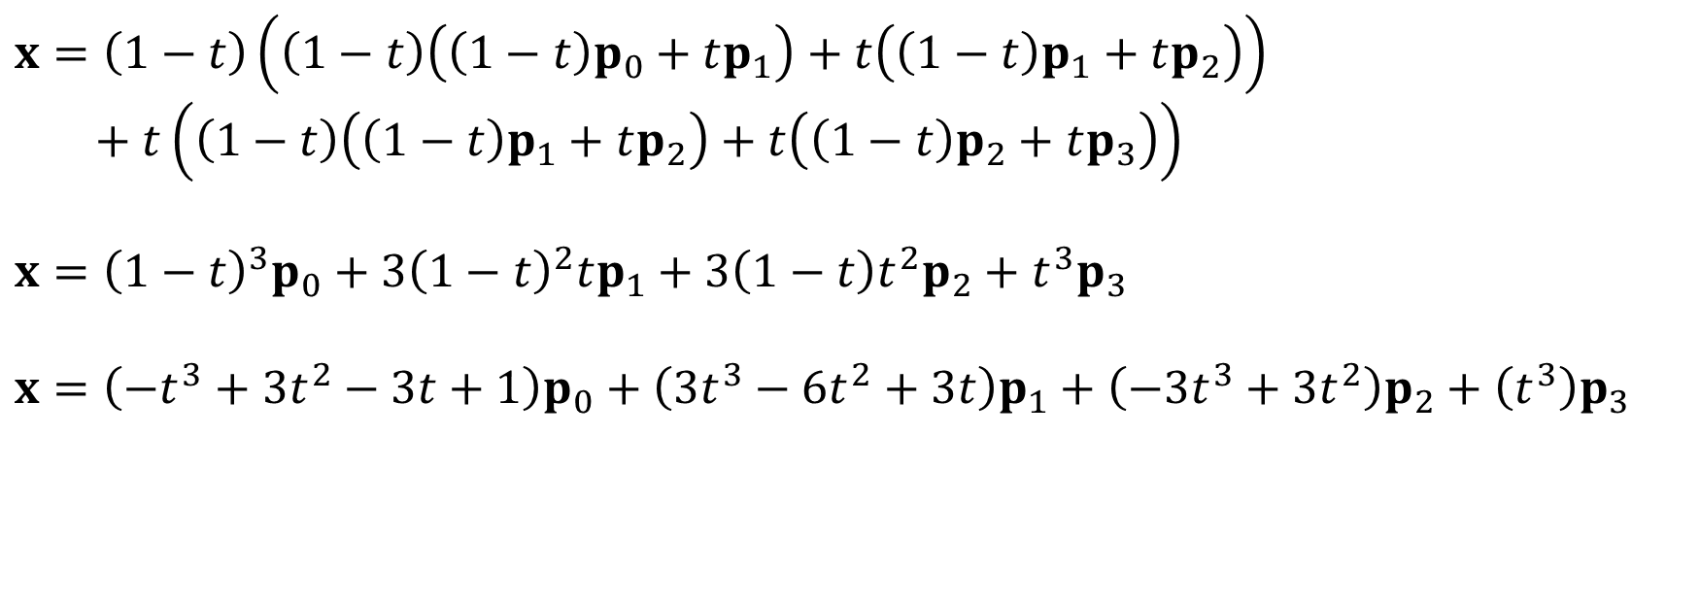
Bernstein Polynomial Form
$$x=\left(1−t\right)\left(\left(1−t\right)\left(\left(1−t\right)p_{0}+tp_{1}\right)+t\left(\left(1−t\right)p_{1}+tp_{2}\right)\right) \\ \begin{matrix} & \end{matrix}+t\left(\left(1−t\right)\left(\left(1−t\right)p_{1}+tp_{2}\right)+t\left(\left(1−t\right)p_{2}+tp_{3}\right)\right)$$
$$x={\left(1−t\right)}^{3}p_{0}+3{\left(1−t\right)}^{2}tp_{1}+3\left(1−t\right)t^{2}p_{2}+t^{3}p_{3}$$
$$x=\left(−t^{3}+3t^{2}−3t+1\right)p_{0}+\left(3t^{3}−6t^{2}+3t\right)p_{1}+\left(−3t^{3}+3t^{2}\right)p_{2}+\left(t^{3}\right)p_{3}$$

Slide 20

Cubic Bernstein Basis Polynomials
$$x=\left(−t^{3}+3t^{2}−3t+1\right)p_{0}+\left(3t^{3}−6t^{2}+3t\right)p_{1}+\left(−3t^{3}+3t^{2}\right)p_{2}+\left(t^{3}\right)p_{3} \\ x= B_{0}^{3}\left(t\right)p_{0} +{ B}_{1}^{3}\left(t\right)p_{1} +{ B}_{2}^{3}\left(t\right)p_{2} +B_{3}^{3}\left(t\right)p_{3}$$
$$B_{0}^{3}\left(t\right)=−t^{3}+3t^{2}−3t+1 \\ B_{1}^{3}\left(t\right)=3t^{3}−6t^{2}+3t \\ B_{2}^{3}\left(t\right)=−3t^{3}+3t^{2} \\ B_{3}^{3}\left(t\right)=t^{3}$$

Slide 21
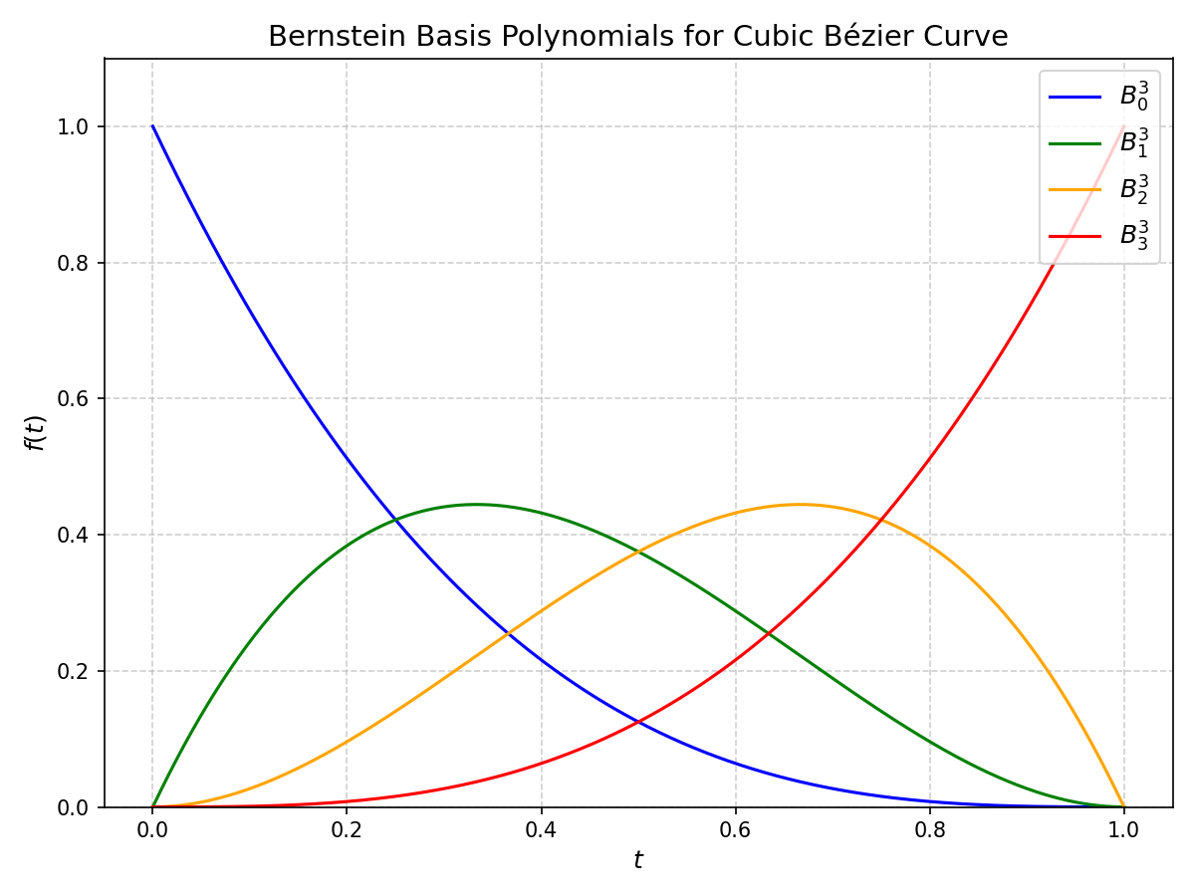
Cubic Bernstein Basis Polynomials
Notes:
Bernstein basis polynomials for cubic Bézier curves. These basis functions are crucial in defining the shape of a Bézier curve, as they determine how much influence each control point has on the curve at any given parameter t.

Slide 22
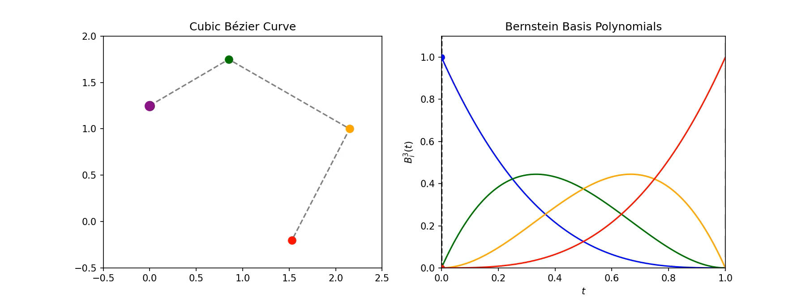
Cubic Bernstein Basis Polynomials
Notes:
Bernstein basis polynomials for cubic Bézier curves. These basis functions are crucial in defining the shape of a Bézier curve, as they determine how much influence each control point has on the curve at any given parameter t.

Slide 23
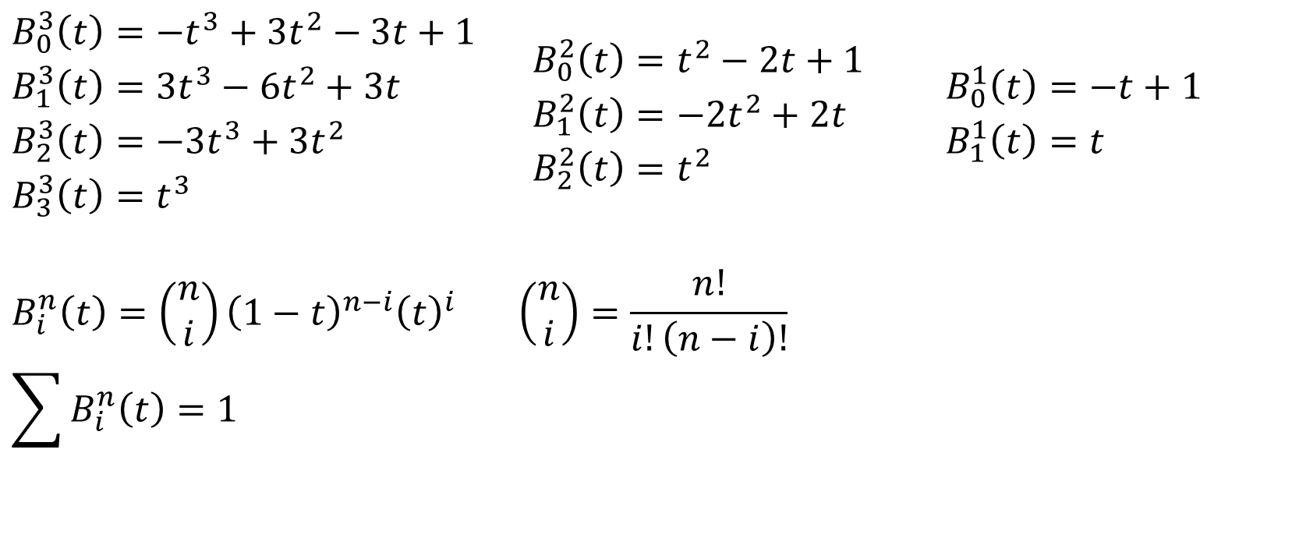
Bernstein Basis Polynomials
Cubic
Quadratic
Linear
$$\begin{matrix}\begin{aligned}&B_{0}^{3}\left(t\right)=−t^{3}+3t^{2}−3t+1 \\ &B_{1}^{3}\left(t\right)=3t^{3}−6t^{2}+3t \\ &B_{2}^{3}\left(t\right)=−3t^{3}+3t^{2} \\ &B_{3}^{3}\left(t\right)=t^{3}\end{aligned} & \begin{aligned}&B_{0}^{2}\left(t\right)=t^{2}−2t+1 \\ &B_{1}^{2}\left(t\right)=−2t^{2}+2t \\ &B_{2}^{2}\left(t\right)=t^{2}\end{aligned} & \begin{aligned}&B_{0}^{1}\left(t\right)=−t+1 \\ &B_{1}^{1}\left(t\right)=t\end{aligned}\end{matrix}$$
$$B_{i}^{n}\left(t\right)=\left(\begin{matrix}n \\ i\end{matrix}\right){\left(1−t\right)}^{n−i}{\left(t\right)}^{i}\begin{matrix} & \end{matrix}\left(\begin{matrix}n \\ i\end{matrix}\right)=\frac{n!}{i!\left(n−i\right)!} \\ \sum{B_{i}^{n}\left(t\right)}=1$$
Notes:
n choose i (combinatorial number)

Slide 24

Bernstein Polynomials
Bernstein polynomial form of a Bezier curve:
$$B_{i}^{n}\left(t\right)=\left(\begin{matrix}n \\ i\end{matrix}\right){\left(1−t\right)}^{n−i}{\left(t\right)}^{i} \\ x\left(t\right)=\sum_{i=0}^{n}{B_{i}^{n}\left(t\right)p_{i}}$$

Slide 25
Bernstein Polynomials
De Casteljau's algorithm gives a recursive method for constructing Bézier curves.
Expanding the recursive steps reveals a polynomial structure:
  Each term is a function of t, weighted by a control point.
This polynomial form leads to the Bernstein polynomials, which define Bézier curves in a more explicit way.
Notes:
The Bernstein polynomial form is the mathematical foundation for Bézier curves. De Casteljau's algorithm is derived from this foundation but presents a different way to compute points on the curve.

Slide 26
Bernstein Polynomials:
Key Insights
Control Point Influence: Each control point’s contribution depends on its corresponding basis function.
Convex Combination: The sum of basis functions is always 1, ensuring the Bézier curve is a weighted average of the control points.
Flexibility and Intuition: Bernstein polynomials provide a clear and powerful way to understand how t controls the curve’s shape.
Notes:
The Bernstein polynomial form is the mathematical foundation for Bézier curves. De Casteljau's algorithm is derived from this foundation but presents a different way to compute points on the curve.

Slide 27
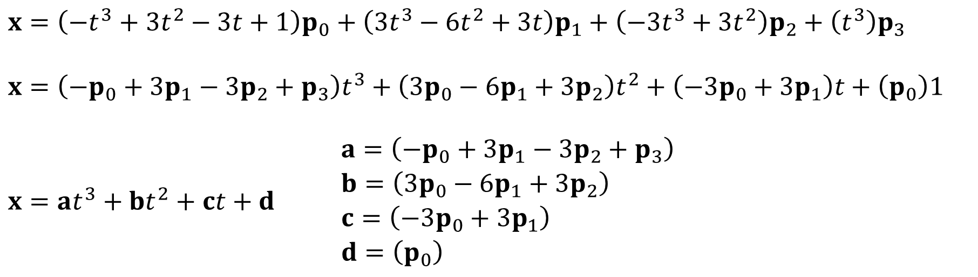
Cubic Equation Form
$$x=\left(−t^{3}+3t^{2}−3t+1\right)p_{0}+\left(3t^{3}−6t^{2}+3t\right)p_{1}+\left(−3t^{3}+3t^{2}\right)p_{2}+\left(t^{3}\right)p_{3}$$
$$x=\left(−p_{0}+3p_{1}−3p_{2}+p_{3}\right)t^{3}+\left(3p_{0}−6p_{1}+3p_{2}\right)t^{2}+\left(−3p_{0}+3p_{1}\right)t+\left(p_{0}\right)1$$
$$x=at^{3}+bt^{2}+ct+d\begin{matrix} & & \begin{aligned}&a=\left(−p_{0}+3p_{1}−3p_{2}+p_{3}\right) \\ &b=\left(3p_{0}−6p_{1}+3p_{2}\right) \\ &c=\left(−3p_{0}+3p_{1}\right) \\ &d=\left(p_{0}\right)\end{aligned}\end{matrix}$$

Slide 28
Cubic Equation Form
By regrouping the Bézier curve equation in terms of t's exponents, we derive the standard cubic form:
Fast Evaluation: All constants a,b,c,da,b,c,d can be precomputed, making evaluation efficient.
The cubic equation form obscures the input geometry, but there is a one-to-one mapping between the two and so the geometry can always be extracted out of the cubic coefficients

Slide 29
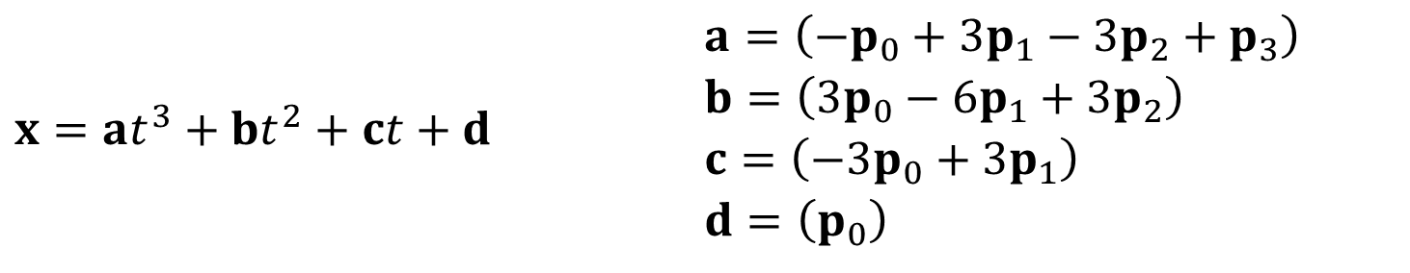
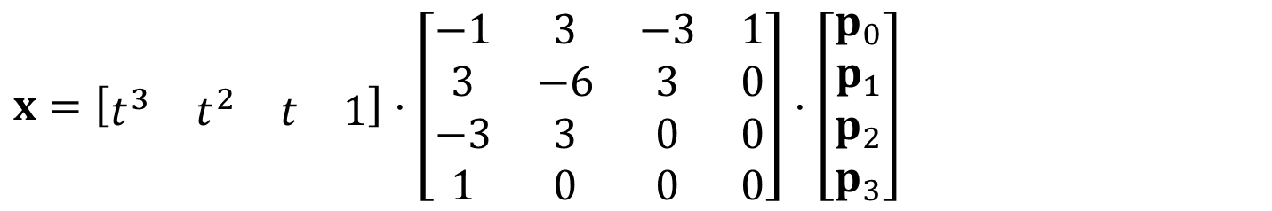
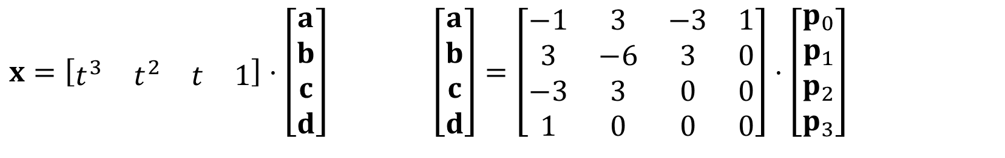
Cubic Matrix Form
$$x=at^{3}+bt^{2}+ct+d\begin{matrix} & & \begin{aligned}&a=\left(−p_{0}+3p_{1}−3p_{2}+p_{3}\right) \\ &b=\left(3p_{0}−6p_{1}+3p_{2}\right) \\ &c=\left(−3p_{0}+3p_{1}\right) \\ &d=\left(p_{0}\right)\end{aligned}\end{matrix}$$
$$x=\left[\begin{matrix}t^{3} & t^{2} & t & 1\end{matrix}\right]⋅\left[\begin{matrix}a \\ b \\ c \\ d\end{matrix}\right] \left[\begin{matrix}a \\ b \\ c \\ d\end{matrix}\right]=\left[\begin{matrix}−1 & 3 & −3 & 1 \\ 3 & −6 & 3 & 0 \\ −3 & 3 & 0 & 0 \\ 1 & 0 & 0 & 0\end{matrix}\right]⋅\left[\begin{matrix}p_{0} \\ p_{1} \\ p_{2} \\ p_{3}\end{matrix}\right]$$
$$x=\left[\begin{matrix}t^{3} & t^{2} & t & 1\end{matrix}\right]⋅\left[\begin{matrix}−1 & 3 & −3 & 1 \\ 3 & −6 & 3 & 0 \\ −3 & 3 & 0 & 0 \\ 1 & 0 & 0 & 0\end{matrix}\right]⋅\left[\begin{matrix}p_{0} \\ p_{1} \\ p_{2} \\ p_{3}\end{matrix}\right]$$

Slide 30
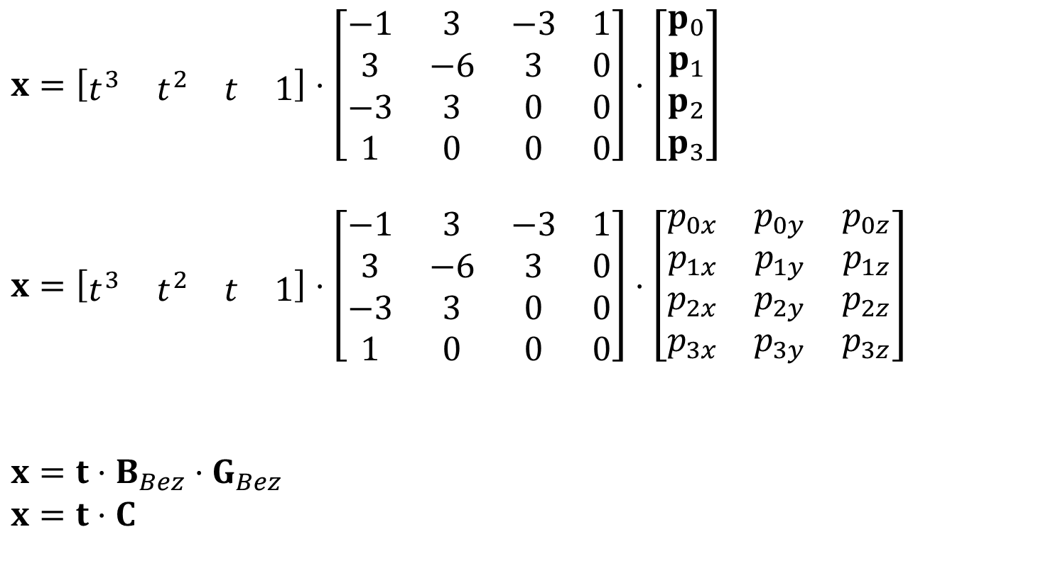
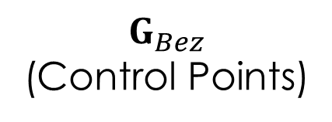
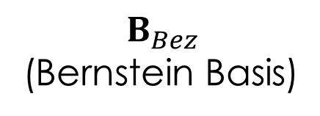
Cubic Matrix Form
$$x=\left[\begin{matrix}t^{3} & t^{2} & t & 1\end{matrix}\right]⋅\left[\begin{matrix}−1 & 3 & −3 & 1 \\ 3 & −6 & 3 & 0 \\ −3 & 3 & 0 & 0 \\ 1 & 0 & 0 & 0\end{matrix}\right]⋅\left[\begin{matrix}p_{0} \\ p_{1} \\ p_{2} \\ p_{3}\end{matrix}\right]$$
$$x=\left[\begin{matrix}t^{3} & t^{2} & t & 1\end{matrix}\right]⋅\left[\begin{matrix}−1 & 3 & −3 & 1 \\ 3 & −6 & 3 & 0 \\ −3 & 3 & 0 & 0 \\ 1 & 0 & 0 & 0\end{matrix}\right]⋅\left[\begin{matrix}p_{0x} & p_{0y} & p_{0z} \\ p_{1x} & p_{1y} & p_{1z} \\ p_{2x} & p_{2y} & p_{2z} \\ p_{3x} & p_{3y} & p_{3z}\end{matrix}\right]$$
$$x=t⋅B_{Bez}⋅G_{Bez}$$
$$x=t⋅C$$
$$B_{Bez}$$
(Bernstein Basis)
$$G_{Bez}$$
(Control Points)
Notes:
First $t⋅B_{Bez}(Bernstein Basis Matrix)$computes the weights (Bernstein polynomials) at a specific t.
Multiplying this result by $G_{Bez}(Control Point Matrix)$​ combines the weights with the control point coordinates, giving the curve point.
$B_{Bez}⋅G_{Bez}$​ can be precomputed into a single matrix $C$
This makes evaluating the Bézier curve for multiple t-values very efficient.

Slide 31
Hermite Form
Let’s look at an alternative way to describe a cubic curve
Instead of defining it with the 4 control points as a Bezier curve, we will define it with a position and a tangent (velocity) at both the start and end of the curve (p₀, p₁, v₀, v₁)
Notes:
Charles Hermite (French pronunciation: ​) (December 24, 1822 – January 14, 1901) was a Frenchmathematician who did research on number theory, quadratic forms, invariant theory, orthogonal polynomials, elliptic functions, and algebra.

Slide 32
Hermite Curve
v₁
v₀
•
p₁
•
https://cubic-bezier.com
p₀

Slide 33
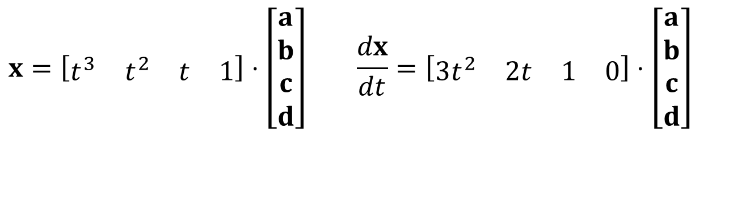
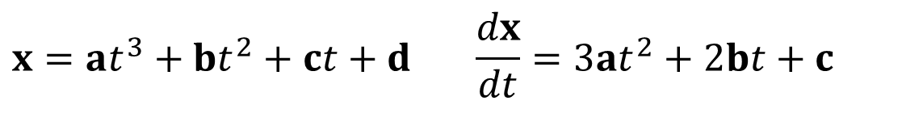
Derivatives
Finding the derivative (tangent) of a curve is easy:
$$x=at^{3}+bt^{2}+ct+d\begin{matrix} & \end{matrix}\frac{dx}{dt}=3at^{2}+2bt+c$$
$$x=\left[\begin{matrix}t^{3} & t^{2} & t & 1\end{matrix}\right]⋅\left[\begin{matrix}a \\ b \\ c \\ d\end{matrix}\right]\begin{matrix} & \end{matrix}\frac{dx}{dt}=\left[\begin{matrix}3t^{2} & 2t & 1 & 0\end{matrix}\right]⋅\left[\begin{matrix}a \\ b \\ c \\ d\end{matrix}\right]$$

Slide 34
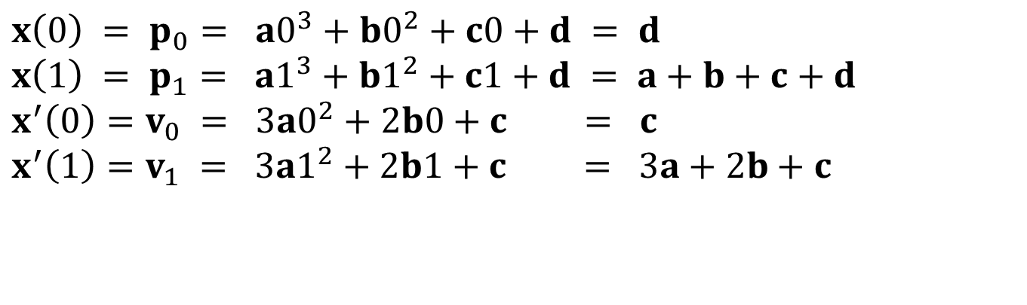
Hermite Curves
We want the value of the curve at t=0 to be x(0)=p₀, and at t=1, we want x(1)=p₁
We want the derivative of the curve at t=0 to be v₀, and v₁ at t=1
$$x\left(0\right) = p_{0}= a0^{3}+b0^{2}+c0+d = d \\ x\left(1\right) = p_{1}= a1^{3}+b1^{2}+c1+d = a+b+c+d \\ x^{′}\left(0\right)=v_{0} = 3a0^{2}+2b0+c = c \\ x^{′}\left(1\right)=v_{1} = 3a1^{2}+2b1+c = 3a+2b+c$$

Slide 35
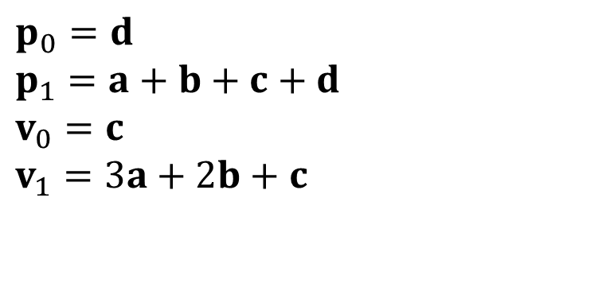
Hermite Curves
$$p_{0}=d \\ p_{1}=a+b+c+d \\ v_{0}=c \\ v_{1}=3a+2b+c$$

Slide 36
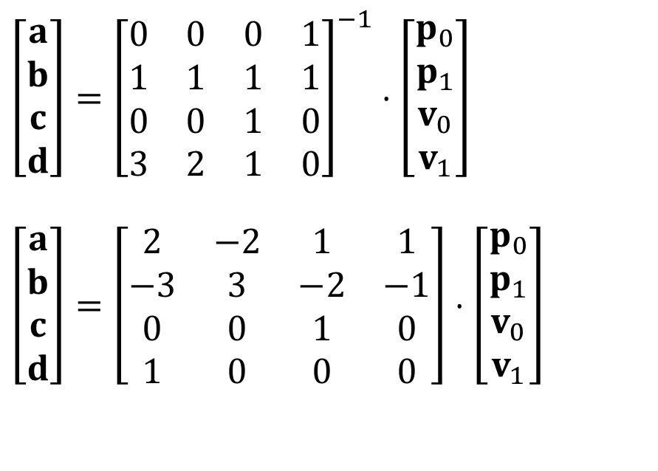
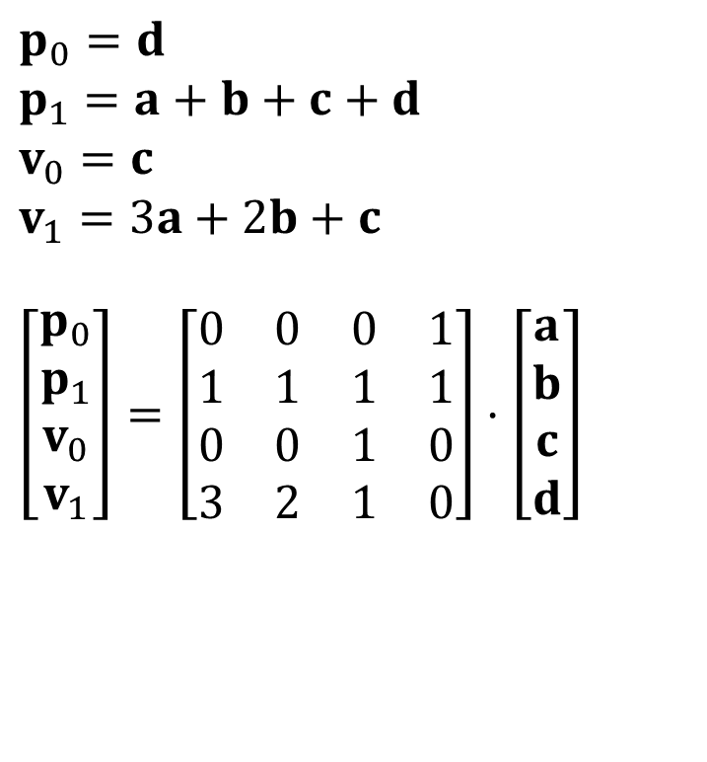
Hermite Curves
$$p_{0}=d \\ p_{1}=a+b+c+d \\ v_{0}=c \\ v_{1}=3a+2b+c$$
$$\left[\begin{matrix}p_{0} \\ p_{1} \\ v_{0} \\ v_{1}\end{matrix}\right]=\left[\begin{matrix}0 & 0 & 0 & 1 \\ 1 & 1 & 1 & 1 \\ 0 & 0 & 1 & 0 \\ 3 & 2 & 1 & 0\end{matrix}\right]⋅\left[\begin{matrix}a \\ b \\ c \\ d\end{matrix}\right]$$
$$\left[\begin{matrix}a \\ b \\ c \\ d\end{matrix}\right]={\left[\begin{matrix}0 & 0 & 0 & 1 \\ 1 & 1 & 1 & 1 \\ 0 & 0 & 1 & 0 \\ 3 & 2 & 1 & 0\end{matrix}\right]}^{−1}⋅\left[\begin{matrix}p_{0} \\ p_{1} \\ v_{0} \\ v_{1}\end{matrix}\right]$$
$$\left[\begin{matrix}a \\ b \\ c \\ d\end{matrix}\right]=\left[\begin{matrix}2 & −2 & 1 & 1 \\ −3 & 3 & −2 & −1 \\ 0 & 0 & 1 & 0 \\ 1 & 0 & 0 & 0\end{matrix}\right]⋅\left[\begin{matrix}p_{0} \\ p_{1} \\ v_{0} \\ v_{1}\end{matrix}\right]$$

Slide 37
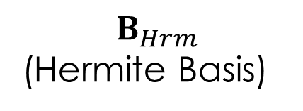
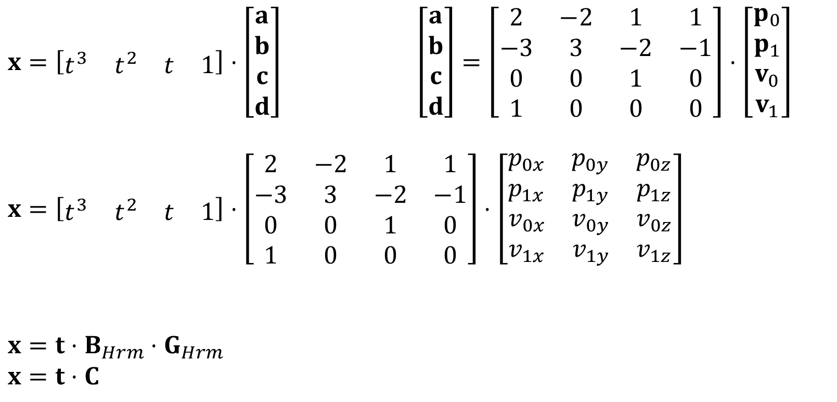
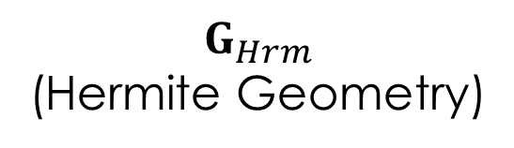
Matrix Form of Hermite Curve
$x=\left[\begin{matrix}t^{3} & t^{2} & t & 1\end{matrix}\right]⋅\left[\begin{matrix}a \\ b \\ c \\ d\end{matrix}\right]$ $\left[\begin{matrix}a \\ b \\ c \\ d\end{matrix}\right]=\left[\begin{matrix}2 & −2 & 1 & 1 \\ −3 & 3 & −2 & −1 \\ 0 & 0 & 1 & 0 \\ 1 & 0 & 0 & 0\end{matrix}\right]⋅\left[\begin{matrix}p_{0} \\ p_{1} \\ v_{0} \\ v_{1}\end{matrix}\right]$
$$x=\left[\begin{matrix}t^{3} & t^{2} & t & 1\end{matrix}\right]⋅\left[\begin{matrix}2 & −2 & 1 & 1 \\ −3 & 3 & −2 & −1 \\ 0 & 0 & 1 & 0 \\ 1 & 0 & 0 & 0\end{matrix}\right]⋅\left[\begin{matrix}p_{0x} & p_{0y} & p_{0z} \\ p_{1x} & p_{1y} & p_{1z} \\ v_{0x} & v_{0y} & v_{0z} \\ v_{1x} & v_{1y} & v_{1z}\end{matrix}\right]$$
$$x=t⋅B_{Hrm}⋅G_{Hrm} \\ x=t⋅C$$
$$B_{Hrm}$$
(Hermite Basis)
$$G_{Hrm}$$
(Hermite Geometry)

Slide 38
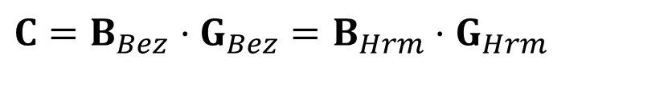
Hermite Curves
The Hermite curve is another geometric way of defining a cubic curve
We see that ultimately; it is another way of generating cubic coefficients
We can also see that we can convert a Bezier form to a Hermite form with the following relationship:
$$C=B_{Bez}⋅G_{Bez}=B_{Hrm}⋅G_{Hrm}$$
Notes:
The equation essentially shows that while Bézier and Hermite curves have different formulations and control mechanisms, they can describe the same underlying curve geometry. This allows software to use whichever representation is most convenient for a given task while maintaining the ability to convert between them as needed.

Slide 39
Keyframes & Channels

Slide 40

Linking Animation to Rigging
Animation System generates poses for the character or object at a specific frame
Rigging System maps poses to the skeleton or control rig. Then converts the posed skeleton and skin into a mesh deformation, producing the updated vertex positions (organized as triangles)
Renderer renders the scene from
the generated triangle data.
Animation
System
pose
$$Φ=\left[\begin{matrix}φ_{1} & φ_{2} & ... & φ_{N}\end{matrix}\right]$$
Rigging
System
triangles
Renderer
Notes:
Animation System: "Defines the keyframes and motion curves.“
Rigging System: "Transforms motion data into poses.“
Renderer: "Generates the final output."

Slide 41


Pose Space
What is Pose Space?
  A pose represents a specific configuration of a character.
  For a character with N Degrees of Freedom (DOFs), a pose is a single point in an N-dimensional pose space:
Animation as Motion in Pose Space
  Animation is a sequence of poses over time.
  In pose space, it is represented as a trajectory or curve:
$$Φ=\left[\begin{matrix}φ_{1} & φ_{2} & ... & φ_{N}\end{matrix}\right]$$
$$Φ=Φ\left(t\right)$$
Notes:
$Φ/φ$: Phi

Slide 42
Pose Space
Types of Animation Paths
  One-Shot Animations: Open curves in pose space (e.g., jump, punch).
  Loop Animations: Closed loops in pose space (e.g., walking, running).
Continuity of Animations
  Continuous: Smooth transitions, typical for realistic animations.
  Discontinuous: Abrupt changes or cuts, useful for effects like teleportation.
Notes:
$Φ/φ$: Phi

Slide 43


Channels
If the entire animation is an N-dimensional curve in pose space, we can separate that into N 1-dimensional curves, one for each DOF
We call these ‘channels’
A channel will refer to pre-recorded or pre-animated data for a DOF, and does not refer to the more general case of a DOF changing over time (which includes physics, procedural animation…)
$$Φ=Φ\left(t\right)$$
$$φ_{i}=φ_{i}\left(t\right)$$

Slide 44
Channels

Slide 45

Array of Channels
An animation can be stored as an array of channels
A simple means of storing a channel is as an array of regularly spaced samples in time
Using this idea, one can store an animation as a 2D array of floats
However, if one wants to use some other means of storing a channel, they could still store an animation as an array of channels, where each channel is responsible for storing data however it wants
$${(N}_{DOFs}∗M_{Frames})$$

Slide 46

Array of Poses
An alternative way to store an animation is as an array of poses
This also forms a 2D array of floats
Which is better, poses or channels?
${(M}_{Frames}$ $∗N_{DOFs})$

Slide 47
Poses vs. Channels
Poses
  Best for simple characters or animations with few DOFs
  Useful for direct keyframe playback without heavy processing.
Channels
  Ideal for complex characters with many DOFs.
  Common in systems that require fine-grained control, such as animation blending, procedural animation, or real-time applications.
  Far more flexible and can potentially use less memory

Slide 48
Keyframe Channel
A channel can be stored as a sequence of keyframes
Each keyframe has a time and a value and usually some information describing the tangents at that location
The curves of the individual spans between the keys are defined by 1-D interpolation (usually piecewise Hermite)
Notes:
Define span
Tangents: These describe how the value approaches and leaves the keyframe, affecting the curve's shape between keyframes.
Spans: The intervals between keyframes.
Piecewise Hermite: A specific type of interpolation that uses cubic polynomials to create smooth curves between points, considering the tangents at each keyframe.

Slide 49
Keyframe
Tangent Out
Tangent In
Value
•
Keyframe (time,value)
Time

Slide 50
Keyframes
•
•
•
•
•
•
•

Slide 51
Why Use Keyframes?
Good user interface for adjusting curves
Give the user control over the value and the velocity of the DOF
Define a perfectly smooth function (if desired)
Can offer good compression

Slide 52
Why Use Keyframes?
Video games may use keyframes for compression purposes, even though they have a performance cost
Keyframed channels form the foundation for animating properties (DOFs) in many commercial animation systems
Cubic Hermite splines (or similar methods) to calculate keyframe transitions
Notes:
While various animation systems employ different mathematical approaches, the majority utilize cubic Hermite splines or similar interpolation methods to calculate keyframe transitions.
Bézier curves: Widely used in computer graphics and animation. They're similar to Hermite splines but use control points instead of tangents.
B-splines: More general than Bézier curves, offering local control over the curve shape.
Catmull-Rom splines: A type of cubic spline that passes through all control points, making it useful for camera paths and motion design.
Kochanek–Bartels splines: An extension of Hermite splines that offers additional control over tension, bias, and continuity.
Cardinal splines: A family of curves that includes Catmull-Rom splines as a special case.
Lagrange polynomials: Used for polynomial interpolation, though less common in animation due to potential oscillation.
Linear interpolation: The simplest form, often used as a baseline or for quick, rough animations.
Cubic splines: A broader category that includes cubic Hermite splines, offering C2 continuity.

Slide 53

Why Use Keyframes?
Notes:
While various animation systems employ different mathematical approaches, the majority utilize cubic Hermite splines or similar interpolation methods to calculate keyframe transitions.
Bézier curves: Widely used in computer graphics and animation. They're similar to Hermite splines but use control points instead of tangents.
B-splines: More general than Bézier curves, offering local control over the curve shape.
Catmull-Rom splines: A type of cubic spline that passes through all control points, making it useful for camera paths and motion design.
Kochanek–Bartels splines: An extension of Hermite splines that offers additional control over tension, bias, and continuity.
Cardinal splines: A family of curves that includes Catmull-Rom splines as a special case.
Lagrange polynomials: Used for polynomial interpolation, though less common in animation due to potential oscillation.
Linear interpolation: The simplest form, often used as a baseline or for quick, rough animations.
Cubic splines: A broader category that includes cubic Hermite splines, offering C2 continuity.

Slide 54
Keyframe Data Structure
class Keyframe {
float Time;
float Value;
float TangentIn,TangentOut;
char RuleIn,RuleOut; // Tangent rules
float A,B,C,D; // Cubic coefficients
}
Notes:
How are tangentin and tangentout floats?

Slide 55
Tangent Rules
Rather than store explicit numbers for tangents, it is often more convenient to store a ‘rule’ and recompute the actual tangent as necessary
Usually, separate rules are stored for the incoming and outgoing tangents
Common rules for Hermite tangents include:
  Flat (tangent = 0)
  Linear (tangent points to next/last key)
  Smooth (automatically adjust tangent for smooth results)
  Fixed (user can arbitrarily specify a value)
Notes:
Remember that the tangent equals the rate of change of the DOF (or the velocity)
Note: ‘v’ for tangents (velocity)

Slide 56
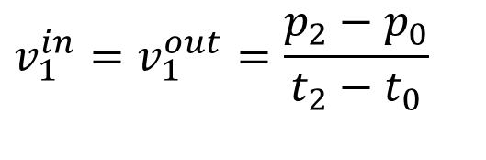
Smooth Tangents
(p₀,t₀)
•
v₁^{in}
(p₂,t₂)
•
•
(p₁,t₁)
v₁^{out}
$$v_{1}^{in}=v_{1}^{out}=\frac{p_{2}−p_{0}}{t_{2}−t_{0}}$$
Notes:
Keep in mind that this won’t work on the first or last tangent (just use the linear rule)

Slide 57
Channel::Precompute()
The two main computations a keyframe channel performs:
  Compute tangents from rules
  Compute cubic coefficients from tangents & other data

Slide 58
Cubic Coefficients
Keyframes are stored in order of their time
Between every two successive keyframes is a span of a cubic curve
The span is defined by the value of the two keyframes and the outgoing tangent of the first and incoming tangent of the second
Those 4 values are multiplied by the Hermite basis matrix and converted to cubic coefficients for the span
For simplicity, the coefficients can be stored in the first keyframe for each span

Slide 59
Hermite Curve (1D)
P(t)
v₁
v₀
•
p₁
•
p₀
t₀
t₁
https://cubic-bezier.com

Slide 60

Matrix Form of Hermite Curve
$$f\left(t\right)=\left[\begin{matrix}t^{3} & t^{2} & t & 1\end{matrix}\right]⋅\left[\begin{matrix}2 & −2 & 1 & 1 \\ −3 & 3 & −2 & −1 \\ 0 & 0 & 1 & 0 \\ 1 & 0 & 0 & 0\end{matrix}\right]⋅\left[\begin{matrix}p_{0} \\ p_{1} \\ v_{0} \\ v_{1}\end{matrix}\right]$$
$$f\left(t\right)=t⋅B_{Hrm}⋅G_{Hrm} \\ f\left(t\right)=t⋅C$$
Remember, this assumes that t varies from 0 to 1
Notes:
Explain this specific 4x4 matrix as the standard Hermite basis matrix
Cubic Hermite Interpolation: This particular 4x4 matrix is used for cubic Hermite splines, which are the most common form of Hermite interpolation. It provides C¹ continuity (continuous first derivative) at the endpoints.

Slide 61
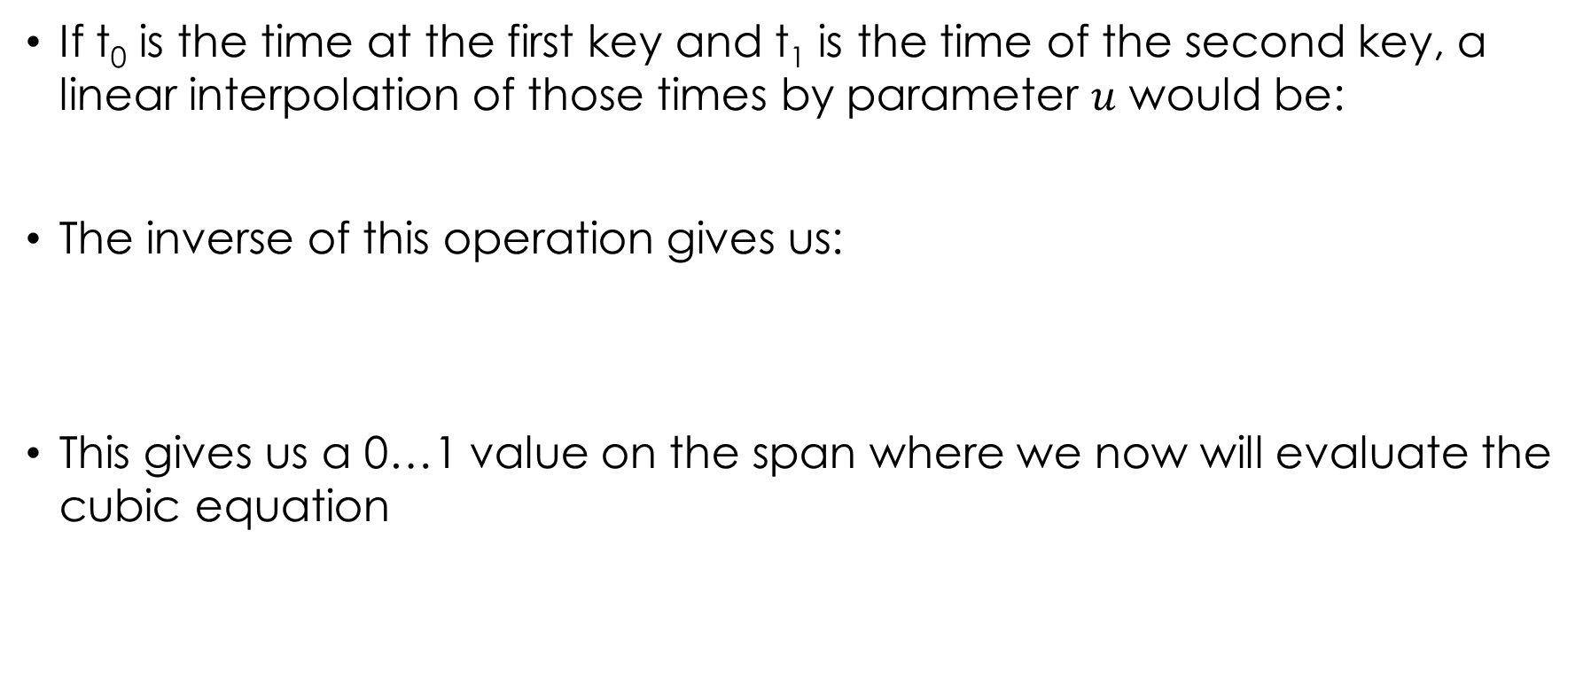
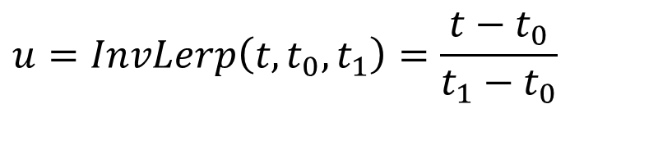
Inverse Linear Interpolation
If t₀ is the time at the first key and t₁ is the time of the second key, a linear interpolation of those times by parameter $u$ would be:
The inverse of this operation gives us:
This gives us a 0…1 value on the span where we now will evaluate the cubic equation
$$t=Lerp\left(u,t_{0},t_{1}\right)=\left(1−u\right)t_{0}+ut_{1}$$
$$u=InvLerp\left(t,t_{0},t_{1}\right)=\frac{t−t_{0}}{t_{1}−t_{0}}$$

Slide 62

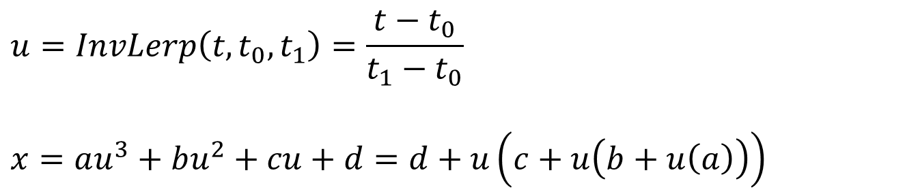
Evaluating the Cubic
To evaluate the cubic equation for a span
  Normalize time within the interval [$t_{0}, { t}_{1}$] to [0, 1] for the span
  Nested form avoids redundant exponentiation, making it faster for real-time applications.
$$u=InvLerp\left(t,t_{0},t_{1}\right)=\frac{t−t_{0}}{t_{1}−t_{0}}$$
$$x=au^{3}+bu^{2}+cu+d=d+u\left(c+u\left(b+u\left(a\right)\right)\right)$$
Notes:
Regular form: 3 multiplications for powers of u (2 for cube and 1 for square) + 3 additional multiplications for coefficients + 3 additions
Nested form: 3 multiplications + 3 additions

Slide 63
Extrapolation Modes
Channels can specify ‘extrapolation modes’ to define how the curve is extrapolated before t_{min} and after t_{max}
Usually, separate extrapolation modes can be set for before and after the actual data
Common choices:
  Constant value (hold first/last key value)
  Linear (use tangent at first/last key)
  Cyclic (repeat the entire channel)
  Cyclic Offset (repeat with value offset)
  Bounce (repeat alternating backwards & forwards)
Notes:
Constant Value: The curve holds the value of the first or last keyframe. Example: A static object before animation starts or after it ends.
Linear: The curve extends linearly using the tangent of the first or last keyframe. Example: A ball moving at a constant velocity.
Cyclic: Repeats the entire animation cycle. Example: A walk cycle animation looping infinitely.
Cyclic Offset: Repeats the animation with an offset, creating a progressive increase or decrease in the value. Example: A staircase animation where each loop adds a step.
Bounce: Repeats the animation by alternating between forward and backward playback. Example: A bouncing ball animation.

Slide 64
Channel::Evaluate()
The Channel::Evaluate function needs to be very efficient, as it is called many times while playing back animations
There are two main components to the evaluation:
  Find the proper span
  Evaluate the cubic equation for the span

Slide 65
Random Access
To evaluate a channel at some arbitrary time t, we need to first find the proper span of the channel and then evaluate its equation
As the keyframes are irregularly spaced, this means we must search for the right one
If the keyframes are stored as a linked list, there is little we can do except walk through the list looking for the right span
If they are stored in an array, we can use a binary search, which should do reasonably well

Slide 66
Sequential Access
If a character is playing back an animation, then it will be accessing the channel data sequentially
Doing a binary search for each channel evaluation for each frame is not efficient for this
If we keep track of the most recently accessed key for each channel, then it is extremely likely that the next access will require either the same key or the very next one
This makes sequential access of keyframes potentially very fast

Slide 67
Anim File
animation {
range [time_start] [time_end]
numchannels [num]
channel {
extrapolate [extrap_in] [extrap_out]
keys [numkeys] {
[time] [value] [tangent_in] [tangent_out]
…
}
}
channel …
}
Notes:
Channel Block (channel): Defines the data for a single channel.
Keys Block (keys [numkeys]): Contains the keyframe data for the channel:
The value of the channel at the given time where the keyframe occurs

Slide 68
Anim classes
Suggested classes:
  Keyframe: stores time, value, tangents, cubics…
  Channel: stores an array (or list) of Keyframes
  Animation: stores an array of Channels
  Player: stores pointer to an animation & pointer to skeleton. Keeps track of time, accesses animation data & poses the skeleton.
Optional:
  Rig: simple container for a skeleton, skin, and morphs
  Pose: array of floats (or just use stl vector)
  ChannelEditor: it’s always nice to separate editor classes from the data

Slide 69
Blending &
Sequencing

Slide 70
Blending & Sequencing
Now that we understand how to manipulate animation data, we can edit and play back simple animation
The subject of blending and sequencing encompasses a higher level of animation playback, involving constructing the final pose out of a combination of various inputs
We will limit today’s discussion to encompass only pre-stored animation (channel) data as the ultimate input. But it is also possible to combine with procedural animation

Slide 71
Blending & Sequencing
Most areas of computer animation have been pioneered by research and the special effects industries, driving technological advancements in high-fidelity visuals.
Blending and sequencing, however, have seen significant progress in video game development, particularly in achieving:
  Real-time interactivity.
  Smooth transitions between complex animations.
  AI-driven character behavior in dynamic environments.

Slide 72
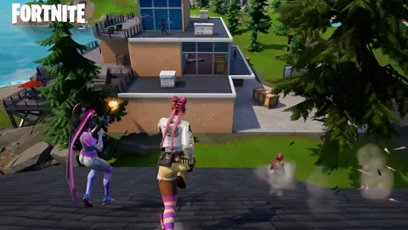
Blending & Sequencing
Recent example:
  Epic Games’ Unreal Engine uses advanced animation blending for real-time interactive characters in games like Fortnite.
  AI systems can seamlessly blend animations for different states (e.g., running, crouching, jumping) to ensure fluid motion.

Slide 73

Blending & Sequencing
The special effects industry has adopted these gaming technologies
  Massive simulations in Marvel movies
  Crowd sequences in shows like Game of Thrones use techniques originally refined in games to manage hundreds of AI-controlled entities.

Slide 74
Animation Playback

Slide 75
Animation Clip
Remember that the AnimationClip stores an array of channels for a particular animation (or it could store the data as an array of poses…)
This should be treated as constant data, especially in situations where multiple animating characters may simultaneously need to access the animation (at different time values)
For playback, animation is accessed as a pose. Evaluation requires looping through each channel.
class AnimationClip {
void Evaluate(float time,Pose &p);
}

Slide 76
Animation Player
We need something that ‘plays’ an animation. We will call it an animation player
At it’s simplest, an animation player would store an AnimationClip*, Rig*, and a float time
As an active component, it would require some sort of Update() function
This update would increment the time, evaluate the animation, and then pose the rig

Slide 77
Animation Player
class AnimationPlayer {
float Time;
AnimationClip *Anim;
Pose P;
public:
void SetClip(AnimationClip &clip);
const Pose &GetPose();
void Update();
};

Slide 78
Animation Blending

Slide 79
Blending Overview
We can define blending operations that affect poses
A blend operation takes one or more poses as input and generates one pose as output
In addition, it may take some auxiliary data as input (control parameters, etc.)

Slide 80
Generic Blend Operation
Notes:
Pose1 ... PoseN: These are the input poses to be blended. Each pose represents a specific configuration of the animated character or object at a particular time (e.g., walking pose, running pose).
Auxiliary Data:
Weights: How much influence each pose has in the blend.
Parameters: Such as speed, direction, or user input, which dynamically adjust the blend.
Context: Environment-related factors (e.g., terrain slope).

Slide 81
Cross Dissolve
Perhaps the most common and useful pose blend operation is the ‘cross dissolve’
Also known as: Lerp (linear interpolation), blend, dissolve…
The cross dissolve blender takes two poses as input and an additional float as the blend factor (0…1)

Slide 82
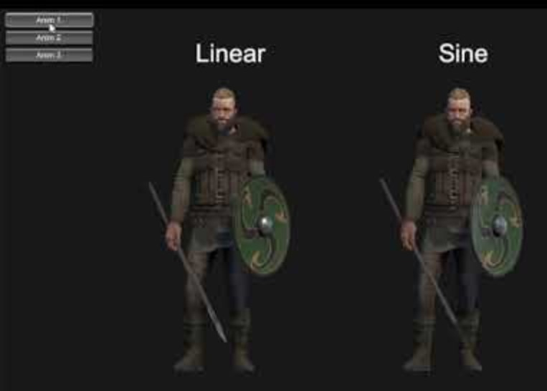
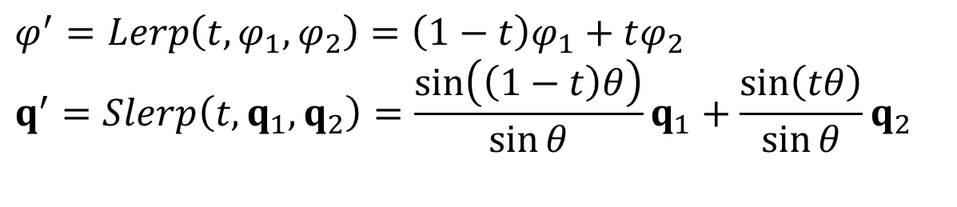
Cross Dissolve
The two poses are basically just interpolated
The DOF values can use Lerp, but the quaternions should use the ‘Slerp’ operation (spherical linear interpolate)
$$φ^{′}=Lerp\left(t,φ_{1},φ_{2}\right)=\left(1−t\right)φ_{1}+tφ_{2} \\ q^{′}=Slerp\left(t,q_{1},q_{2}\right)=\frac{\sin\left(\left(1−t\right)θ\right)}{\sin{θ}}q_{1}+\frac{\sin\left(tθ\right)}{\sin{θ}}q_{2}$$

Slide 83
Basic Math Blend Operations
We can also define some blenders for basic math operations:

Slide 84



Add & Subtract Blenders
A reasonable behavior for an add blender could be:
For subtraction, we could multiply by the conjugate of the quaternion
$$φ^{′}=φ_{1}+φ_{2} \\ q^{′}=q_{1}q_{2}$$
$$φ^{′}=φ_{1}−φ_{2} \\ q^{′}=q_{1}q_{2}^{∗}$$
$$q^{∗}=\left[\begin{matrix}q_{0} & −q_{1} & −q_{2} & −q_{3}\end{matrix}\right]$$

Slide 85
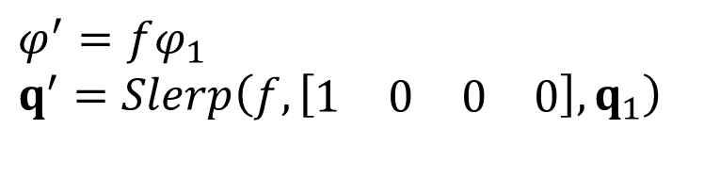
Scale Blender
As we want our quaternions to stay unit length, we don’t really want to scale them
In any case, scaling a quaternion has no effect on the resulting orientation!
Instead, we can think of scaling as moving towards or away from 0 (I.e., scaling by a number less than 1 brings us closer to 0, scaling by >1 takes us away from 0…)
Therefore, we could define the scale blender as:
$$φ^{′}=fφ_{1} \\ q^{′}=Slerp\left(f,\left[\begin{matrix}1 & 0 & 0 & 0\end{matrix}\right],q_{1}\right)$$
Notes:
Quaternions are mathematical constructs often used to represent rotations in 3D space
Instead of traditional scaling, the operation is interpreted as moving the quaternion closer to or farther from the identity quaternion (the neutral rotation [1,0,0,0][1, 0, 0, 0][1,0,0,0]).

Slide 86
Body Turn
As an example of math blending operations, consider a character that walks and turns
One approach to achieving this is to have an underlying walk animation and somebody turn on top of it
We make a static ‘look_right’ pose and a static ‘default’ pose
The subtraction gives us the difference between look_right and default
If we scale this and then add it on top of the underlying walk animation. The scale we use can be based on how hard the character is turning (-1…1)

Slide 87
Math Operations: Body Turn

Slide 88
Bilinear Blend
Notes:
A bilinear blend combines four poses (pose1, pose2, pose3, pose4) using two independent interpolation parameters, sss and ttt.It produces a smoothly interpolated output pose that lies between these four poses.
Blending between idle, walking, running, and sprinting animations based on player speed and direction.
The two methods are equivalent in their mathematical basis but differ in implementation structure and computational approach.

Slide 89
Bilinear Blend
Bilinear blend is an extension to the cross dissolve that takes four input poses and two interpolation parameters s & t
Blending example in Unity: https://www.youtube.com/watch?v=HeHvlEYpRbM

Slide 90

Bilinear Blend

Slide 91
Bilinear Blend
Bilinear blends can be useful for a wide range of applications
As one example, consider a video game character who must aim a weapon
The character must be able to stand still and aim at any object within +/- 135 degrees to the side to side and +/- 45 degrees up and down
An animator can supply key poses at 45 degrees increments in both directions
Then, for any desired angle, we can find the right four targets and do a bilinear blend

Slide 92
Animation State Machines

Slide 93
State Machines
Blending is great for combining a few motions, but it does not address the issue of sequencing different animations over time
For this, we will use a state machine
We will define the state machine as a connected graph of states and transitions
At any time, exactly one of the states is the current state
Transitions are assumed to happen instantaneously

Slide 94
State Machines

Slide 95
State Machines
In the context of animation sequencing, we think of states as representing individual animation clips and transitions being triggered by some sort of event
An event might come from some internal logic or some external input (button press…)

Slide 96
More Complex Jump

Slide 97
Next lecture November 20th:
Skinning and Facial Animation
09:15 – 11:00 or 10:00 – 11:45 or 11:00 - 12:45
See you on Wednesday!

