Slide 1
Computer Animation - Lecture 3a Skinning
Bringing Characters to Life Through Dynamic Deformations
Metehan Doyran m.doyran@uu.nl

Slide 2
Outline
Introduction to Skinning
Smooth Skinning Algorithm
Rigging Process
Skinning Challenges
Advanced Techniques
Anatomical Models
Body Scanning

Slide 3
What is Skinning?
Attaching a skin mesh to a skeleton
It provides realistic movement
https://autonomousvision.github.io/snarf/
https://igl.ethz.ch/projects/fast/
Notes:
Start with an overview slide and possibly combine skinning with facial animation slides!

Slide 4
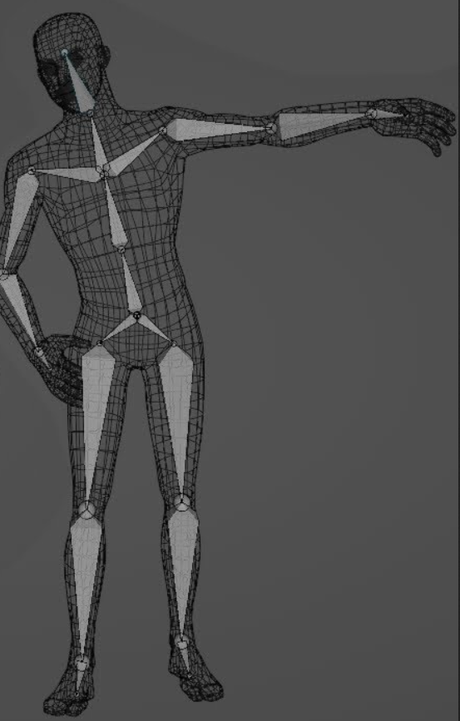
Rigging Process
We need a geometric skin mesh and a skeleton
Usually, the skin is built in a relatively neutral pose, often in a comfortable standing pose
The skeleton, however, might be built in more of a zero pose where the joints DOFs are assumed to be 0, causing a very stiff, straight pose
To attach the skin to the skeleton, the skeleton must first be posed into a binding pose
Once this is done, the vertices can be assigned to joints (with weights)
Notes:
The binding pose is typically a neutral, natural pose that serves as a baseline for deformation. Examples include:
A T-pose, where the arms are extended horizontally, forming a "T" shape.
An A-pose, with arms angled slightly downward.
This makes it easier to model and rig the character symmetrically.

Slide 5
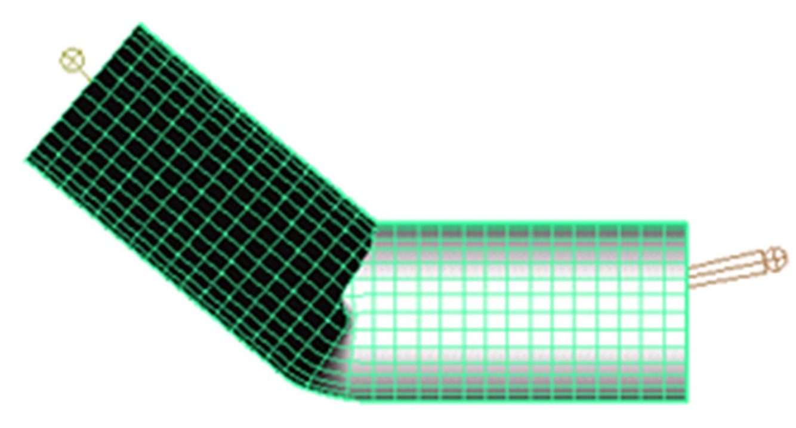
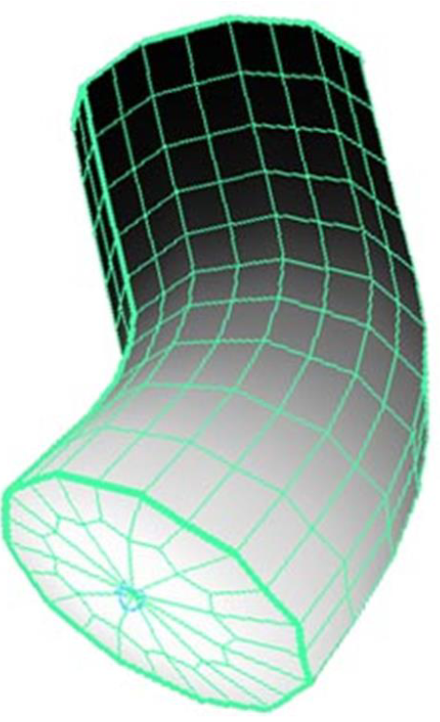
Binding Matrices
Rigid parts or simple skin:
v can be defined local to the joint that transforms it
Smooth skin:
several joints transform a vertex, but it can’t be defined local to all of them
Instead, we must first transform it to be local to the joint that will then transform it to the world
To do this, we use a binding matrix B for each joint that defines where the joint was when the skin was attached and pre-multiply its inverse with the world matrix:
$$M_{i}={B_{i}}^{−1}⋅W_{i}$$

Slide 6
Classic Linear Smooth Skinning
A vertex can be attached to more than one joint with adjustable weights that control how much each joint affects it.
Vertices rarely need to be attached to more than three joints.
Each vertex is transformed a few times, and the results are blended.
Other names:
blended skin,
skeletal subspace deformation (SSD),
multi-matrix skin,
matrix palette skinning…

Slide 7
Smooth Skin Algorithm
The deformed vertex position is a weighted average:
$$v^{′}=w_{1}\left(v⋅M_{1}\right)+w_{2}\left(v⋅M_{2}\right)+...w_{N}\left(v⋅M_{N}\right) \\ or \\ v^{′}=\sum{w_{i}\left(v⋅M_{i}\right)} \\ where \\ \sum{w_{i}=1}$$
Notes:
M: transformation matrix for vertices

Slide 8
Smooth Skin Algorithm
Step 1: Define the initial alignment, B, between the skeleton and skin mesh, ensuring joints are positioned correctly within the mesh.
Step 2: Transform the vertex positions into the joint's local coordinate space using the inverse of the binding matrix.
Step 3: Apply the skeleton's current transformations (e.g., rotations, translations) to compute the global position of each joint.
Step 4: Blend the transformed vertex positions based on the joint weights to compute the final vertex position.
Normals may need separate transformation or blending to ensure correct lighting effects.

Slide 9
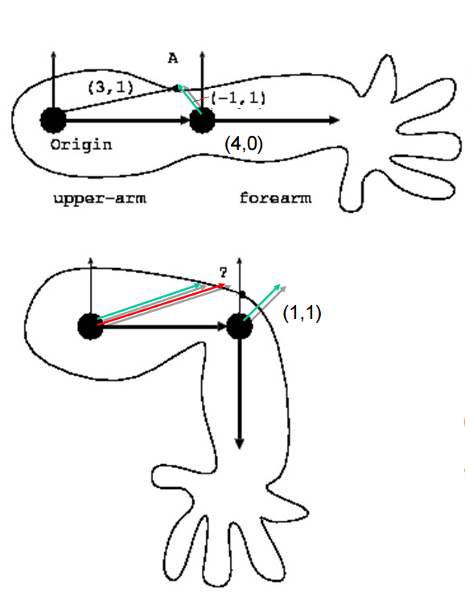
Example
What is the position of point A after the elbow is bent 90 degrees?
$W_{\text{shoulder}}$ = 0.8
$W_{\text{elbow}}$= 0.2
Notes:
Make the example better

Slide 10
Example
Based on only the transformation of the shoulder the final position of the vertex should be (3,1)
Based on only the transformation of the elbow the final position of the vertex should be (1,1), w.r.t elbow, which is (5,1) w.r.t. shoulder
0.8*(3,1) + 0.2*(5,1) = (3.4, 1)

Slide 11
Rig Data Flow
$$Φ=\left[\begin{matrix}φ_{1} & φ_{2} & ... & φ_{N}\end{matrix}\right]$$
Input DOFs
Rigging system
(skeleton, skin…)
Output renderable mesh
(vertices, normals…)
Rig
$$v^{′},n^{′}$$

Slide 12
Painting weights
Notes:
Add the video

Slide 13
Algorithm Overview
Skin::Update() (view independent processing)
Compute skinning matrix for each joint: M=B⁻¹·W (you can precompute and store B⁻¹ instead of B)
Loop through vertices and compute blended position & normal
Skin::Draw() (view dependent processing)
Loop through triangles and draw using world space positions & normals
Notes:
View-Independent: Calculations that don't depend on the camera view, such as computing transformations.
View-Dependent: Calculations based on the camera, like rendering visible triangles.

Slide 14
Skinning Equations
$$L=L_{jnt}\left(φ_{1},φ_{2},...,φ_{N}\right) \\ W=L⋅W_{parent}$$
$$v^{′}=\sum{w_{i}v⋅B_{i}^{−1}⋅W_{i}} \\ n^{∗}=\sum{w_{i}n⋅B_{i}^{−1}⋅W_{i}} \\ n^{′}=\frac{n^{∗}}{\left|n^{∗}\right|}$$
$L$: Local transformation matrix
$W$: Global transformation matrix
Skeleton
Skinning
$v$: The vertex position
$n$: The vertex normal
Notes:
v: The position of the vertex in the binding pose.
wi​: The weight of the i-th joint's influence on the vertex.
Bi−1​: The inverse of the binding matrix for the i-th joint, transforming the vertex from binding pose space to joint space.
Wi​: The global transformation matrix of the i-th joint.
v′: The final deformed position of the vertex.
Normalizes the blended normal n∗n^*n∗ to ensure it maintains a unit length, which is crucial for correct lighting calculations.

Slide 15
Limitations of Smooth Skin
Smooth skin is very simple and quite fast, but its quality is limited
The main problems are:
Joints tend to collapse as they bend more
Very difficult to get specific control
Unintuitive and difficult to edit
Still, it is built into most 3D animation packages
If nothing else, it is a good baseline upon which more complex schemes can be built

Slide 16
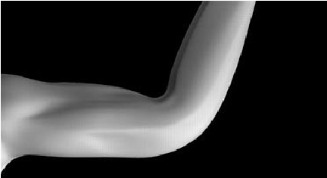
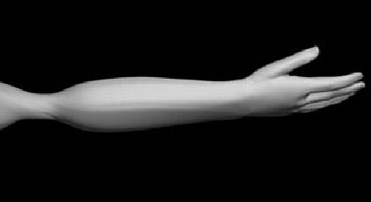
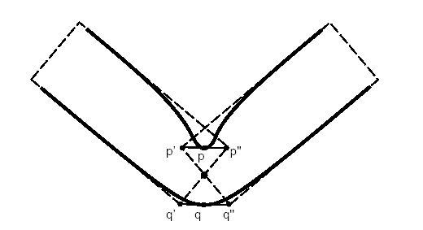
Limitations of Smooth Skin
Skin collapse (bending)
Twisting (candy wrapper)

Slide 17
Skin collapse (bending)

Slide 18
Twisting (candy wrapper)

Slide 19
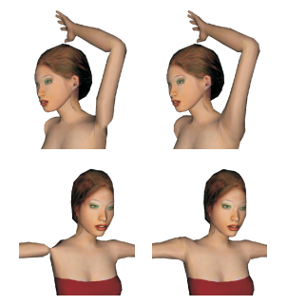
Dual quaternion blending
Proposed to overcome the bending and candy wrapper effects
Currently, found in most 3D modelling tools, e.g. Maya, Blender
Geometric Skinning with Approximate Dual Quaternion Blending, Kavan Collins, Zara and O'Sullivan, Siggraph 2008

Slide 20
Shape Interpolation
An extension to the smooth skinning algorithm allows corrective shapes (blend shapes) to be defined for specific key poses along a joint's motion range.
For example, an elbow can have a blend shape defined for the straight rest pose and another for the fully bent pose.
These corrective shapes are interpolated in the local space of the bones based on the joint's angle or pose parameters before skinning transformations are applied.

Slide 21
Shape Interpolation Algorithm
$$v^{′}=v_{base}+\sum{φ_{i}⋅\left(v_{i}−v_{base}\right)}$$
To compute a blended vertex position: The blended position is the base position plus a contribution from each corrective shape, weighted by the joint's current DOF value.
To blend the normals, we use a similar equation: Normals are blended but not normalized at this stage; normalization will occur later during skinning for computational efficiency.
This approach ensures smooth deformation by blending corrective shapes and their normals in response to the joint's motion.
$$n^{′}=n_{base}+\sum{φ_{i}⋅\left(n_{i}−n_{base}\right)}$$
Notes:
ϕi​: The weight (influence) of the corrective shape i, based on the joint's Degrees of Freedom (DOF).
The final vertex position is calculated by adding the weighted differences between the corrective shapes and the base position.

Slide 22
Layered Approach
We use a simple layered approach
Skeleton Kinematics
Shape Interpolation
Smooth Skinning
Most character rigging systems are based on some sort of layered system approach combined with general purpose data flow to allow for customization

Slide 23
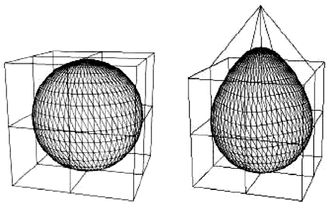
Free-Form Deformations
FFDs are a class of deformations where a low detail control mesh is used to deform a higher detail skin
There are a lot of variations on FFDs based on the topology of the control mesh

Slide 24
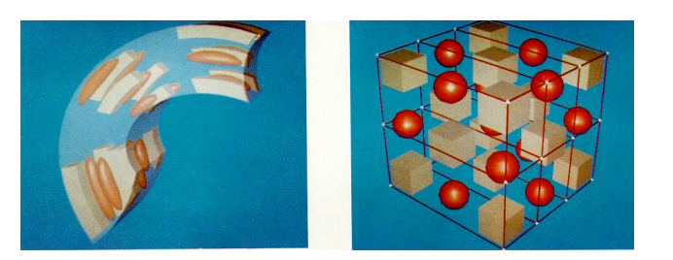
Lattice FFDs
The original type of FFD uses a simple regular lattice placed around a region of space
The lattice is divided up into a regular grid
When the lattice points are then moved, they describe smooth deformation in their vicinity
Notes:
Any better visualizations?

Slide 25
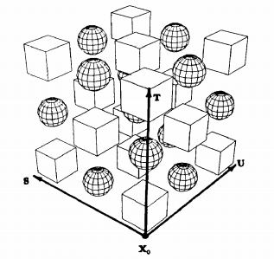
Lattice FFDs
We start by defining the undeformed lattice space:
$$x\left(s,t,u\right)=x_{0}+s⋅s_{0}+t⋅t_{0}+u⋅u_{0}$$
$$0≤s≤1$$
$$0≤t≤1$$
$$0≤u≤1$$
$$M=\left[\begin{matrix}s_{x} & s_{y} & s_{z} & 0 \\ t_{x} & t_{y} & t_{z} & 0 \\ u_{x} & u_{y} & u_{z} & 0 \\ x_{0x} & x_{0y} & x_{0z} & 1\end{matrix}\right]$$
Notes:
Lattice Free-Form Deformations (FFDs) are used to deform 3D objects by embedding them in a lattice (a grid of control points) and manipulating that lattice to apply smooth, global transformations.
The function x(s,t,u) represents a point in the lattice space
x0​: The origin of the lattice in 3D space.
s0,t0, ​: Basis vectors defining the lattice's local axes.
s,t,u: Parametric coordinates (ranging from 0 to 1) within the lattice along the three dimensions.
Purpose: This defines how the object is embedded in the lattice. A point in the object's space maps to a point in the lattice via this function.
M: A matrix that represents the affine transformation of the lattice.

Slide 26
Lattice FFDs
We then define the number of sections in the 3 lattice dimensions:
1 <= l,m,n <= 3
And then set the initial lattice positions (control points): p_{ijk}
$$p_{ijk}=x_{0}+\frac{i}{l}⋅s_{0}+\frac{j}{m}⋅t_{0}+\frac{k}{n}⋅u_{0}$$

Slide 27
Lattice FFDs
Convert world-space coordinates to lattice space:
Deform the point using a trivariate Bernstein polynomial:
$$x⋅M^{−1}=\left[\begin{matrix}s & t & u & 1\end{matrix}\right]$$
$$x_{ffd}=\sum_{i=0}^{l}{\left(\begin{matrix}l \\ i\end{matrix}\right){\left(1−s\right)}^{l−i}s^{i}⋅\left(\sum_{j=0}^{m}{\left(\begin{matrix}m \\ j\end{matrix}\right){\left(1−t\right)}^{m−j}t^{j}⋅\left(\sum_{k=0}^{n}{\left(\begin{matrix}n \\ k\end{matrix}\right){\left(1−u\right)}^{n−k}u^{k}⋅p_{ijk}}\right)}\right)}$$
Notes:
pijk​: Control points of the lattice.
(1−s),(1−t),(1−u): Terms representing the "blending" effect in the lattice space.
Similar to Bézier curves, this approach uses Bernstein polynomials for smooth interpolation, generalized to 3D lattice spaces.
Used in character animation, modeling, and deformation tasks, such as facial expressions or bending soft bodies.

Slide 28
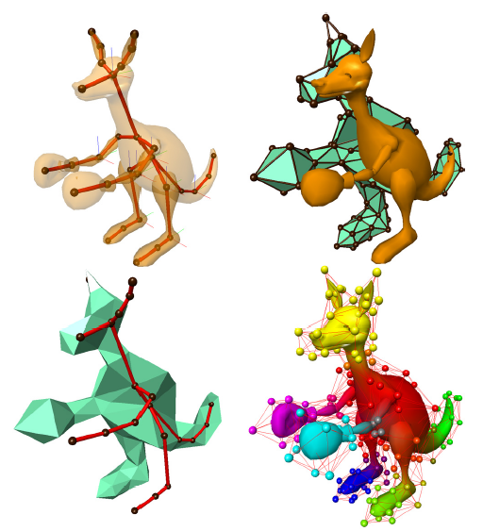
Arbitrary Topology FFDs
The concept of FFDs was later extended to allow an arbitrary topology control volume to be used
Steve Capell, Seth Green, Brian Curless, Tom Duchamp, and Zoran Popović. 2002. Interactive skeleton-driven dynamic deformations. In Proceedings of the 29th annual conference on Computer graphics and interactive techniques (SIGGRAPH '02).
Notes:
Arbitrary Topology FFDs allow animators and riggers to deform highly complex and irregular meshes more efficiently and with greater control.
They are particularly useful in game development or animated films, where characters often require high-quality deformations in real time or pre-rendered sequences.

Slide 29
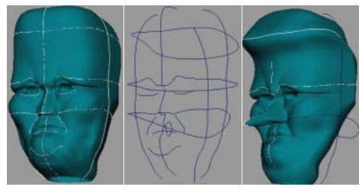
Axial Deformations & Wires
Allows the user to place lines or curves within a skin
When the lines or curves are moved, they distort the space around them
Multiple lines & curves can be placed near each other and will properly interact
Karan Singh and Eugene Fiume. 1998. Wires: a geometric deformation technique. In Proceedings of the 25th annual conference on Computer graphics and interactive techniques (SIGGRAPH '98).

Slide 30
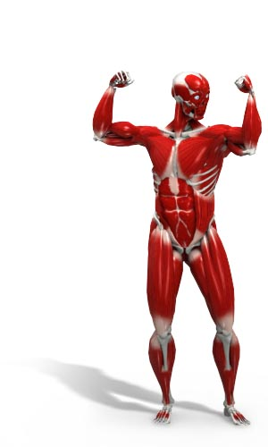
Anatomical Modeling
The motion of the skin is based on the motion of the underlying muscle and bones.
In an anatomical simulation, the tissue beneath the skin must be accounted for.
One can model the bones, muscle, and skin tissue as deformable bodies and then use physical simulation to compute their motion
Various approaches exist ranging from simple approximations using basic primitives to detailed anatomical simulations
Notes:
Simplify

Slide 31
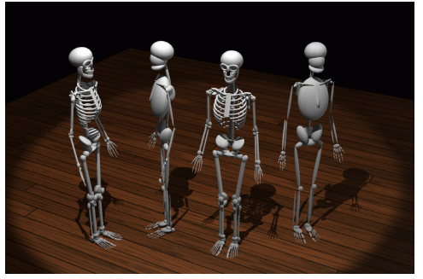
Simple Anatomical Models
Some simplified anatomical models use ellipsoids to model bones and muscles
Ferdi Scheepers, Richard E. Parent, Wayne E. Carlson, and Stephen F. May. 1997. Anatomy-based modeling of the human musculature. In Proceedings of the 24th annual conference on Computer graphics and interactive techniques (SIGGRAPH '97)

Slide 32
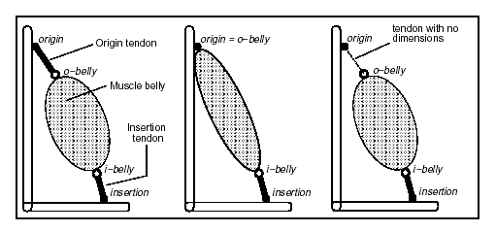
Simple Anatomical Models
Muscles are attached to bones, sometimes with tendons as well
The muscles contract in a volume preserving way, thus getting wider as they get shorter

Slide 33
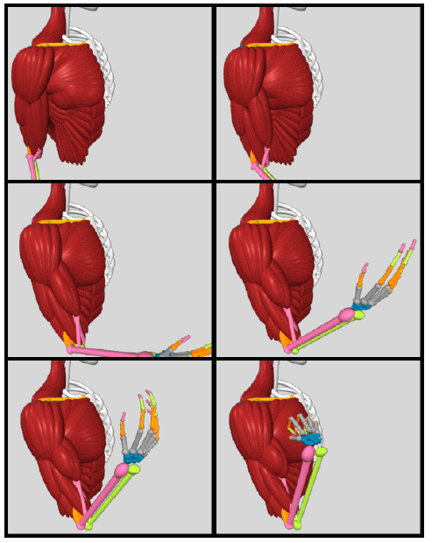
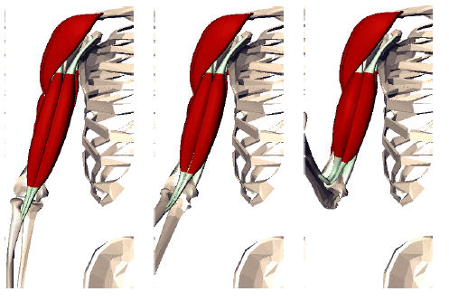
Simple Anatomical Models
Complex musculature can be built up from lots of simple primitives

Slide 34
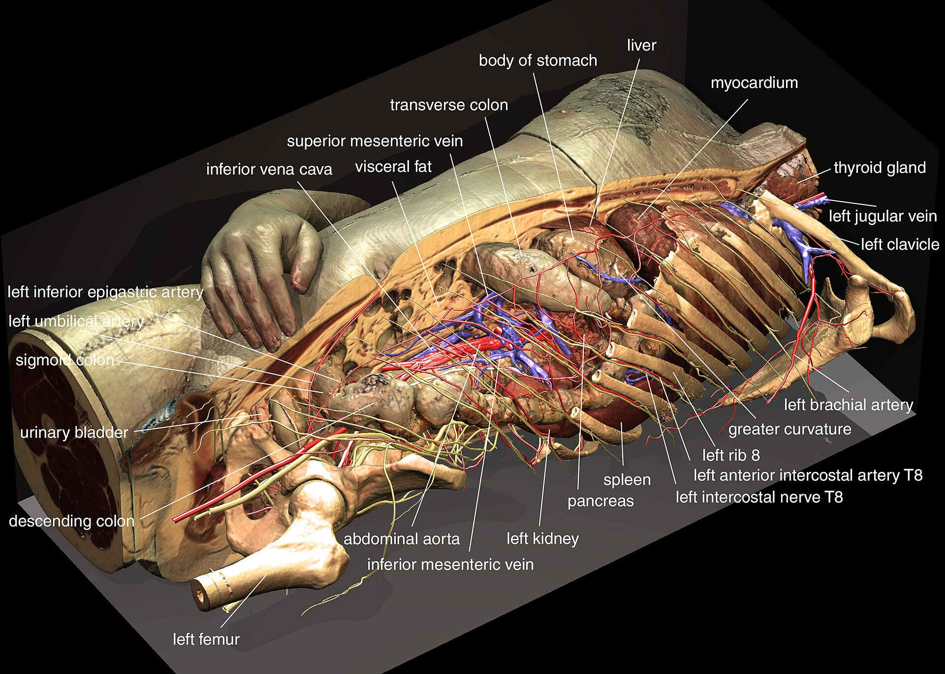
Detailed Anatomical Models
One can also do detailed simulations that accurately model bone & muscle geometry, as well as physical properties
https://en.wikipedia.org/wiki/Visible_Human_Project
Notes:
what is the mri scan?

Slide 35
Body Scanning
Data input has become an important issue for the various types of data used in computer graphics
Examples:
Geometry: Laser scanners
Motion: Optical motion capture
Faces: Computer vision
Recently, people have been researching techniques for directly scanning human bodies and skin deformations
Notes:
Simplify

Slide 36
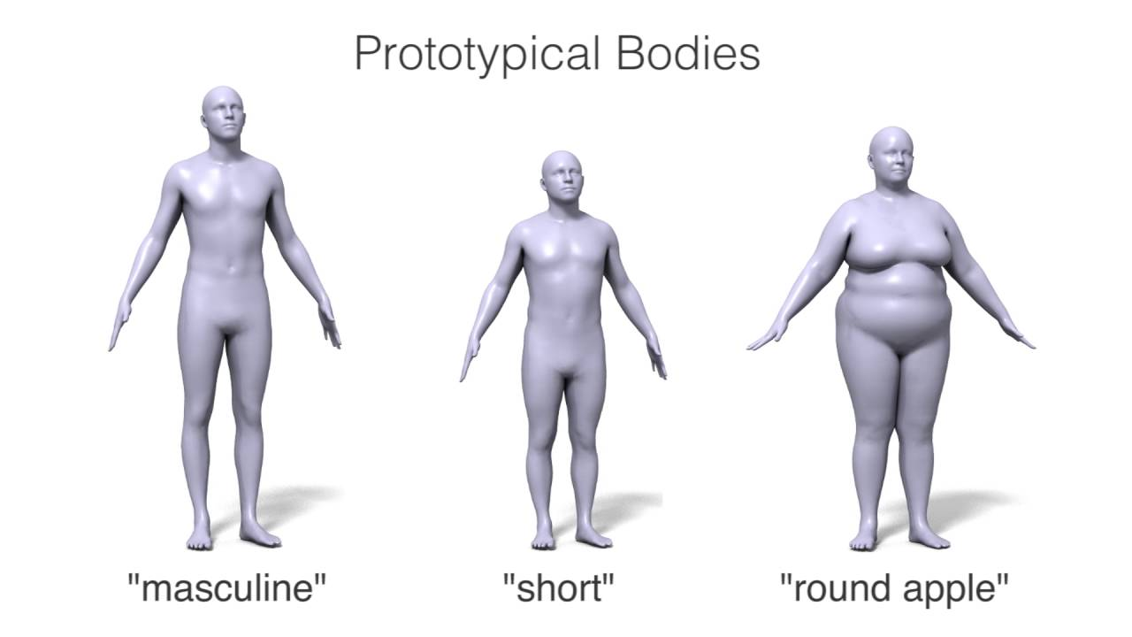
Body Scanning
Practical approaches tend to use either a 3D model scanner (like a laser) or a 2D image-based approach (computer vision)
The skin is scanned at various key poses and some sort of 3D model is constructed
http://graphics.cs.cmu.edu/projects/muscle/
http://dyna.is.tue.mpg.de/

Slide 37
Body Scanning – Auto Rigging
Some techniques attempt to fit this back onto a standardized mesh, so that all poses share the same topology. This is difficult, but it makes the interpolation process much easier. https://www.mixamo.com

Slide 38
Supplementary Material
Siggraph course on skinning (2014): https://dl.acm.org/doi/10.1145/2614028.2615427
Siggraph course on “Learning body shapes in motion”, 2016 https://dl.acm.org/doi/10.1145/2897826.2927326
Some of the slides of this lecture are based on the Computer Animation course at the University of California San Diego.

