Slide 1
Computer Animation
[INFOMCANIM 2025-26]
Lecture 1: Introduction & Animation Basics

Slide 2




Teaching Team
Dr. Zerrin Yumak, Associate Professor
Human-Centered Computing Group
Kazi Haque, PhD Candidate
Human-Centered Computing Group
Dr. Metehan Doyran, Assistant Professor
Social and Affective Computing Group
Alessandro Busacci, Teaching Assistant
Game and Media Technology student

Slide 3
Today’s lecture
Goals of the course
Assignments
History of Computer Animation
Animation basics
Forward Kinematics
Orientation
Quaternions

Slide 4
Goals of the course
Introduction to basic techniques in Computer Animation
  Motion synthesis, facial & body animation, …
Introduction to research topics
  Giving presentations
  Reading and evaluating research papers
  Writing an essay about an animation topic
Hands-on experience
  Short animation movie production or mini research project

Slide 5
Grading
Grading:
  Research papers (R)
  Project (P)
  Essay (E)
  Final grade = 0.3*R + 0.4*P + 0.3*E
    Condition: E >= 5
*Pay attention that R is based on your presentations but also involves paper summaries. You will not get a separate grade for the summaries, but it is part of the overall grade R.

Slide 6
Attendance
Attendance is overall not mandatory, but..
  You are required to attend the lectures with student presentations you wrote a review for.

Slide 7
Research papers
You will upload a one A4 page review for each paper on Brightspace. In total, you should have 6 reviews.
  Similar to peer-review process of conferences and journals
Deadline for submitting these reviews is one day before the lecture that the paper will be presented (until 23:59)
You are not limited to 6 papers though, read as much as you can, participate the presentations and ask questions!
Note: You can ask your questions on the “Research papers and presentation” channel on Teams INFOMCANIM 2026.

Slide 8
Research papers
Content of one page review:
  Summary: A short summary about what the paper is about, what is the method and results.
  Assessment: Critical analysis of the paper, advantages/disadvantages of the method, clarity, technical correctness, novelty
  Questions: Two questions about the paper (to be asked in the lecture)

Slide 9
Presentation
Presentation should discuss the contents of the paper
  What is it about, what is the contribution, what are the drawbacks of the proposed method…
Presentations will be evaluated according to:
  Content
  Visual aids
  Delivery
  Ability to answer questions
Presentation grade will be given to you the next session.

Slide 10
Presentation outline
High-level overview and motivation of the paper
Clear problem statement
Related work and background information
Technical details of the approach
Critical analysis of the approach & evaluation
Possible improvements of the paper (future work)
Questions from the audience & discussion

Slide 11
Presentation preparation
Do a ‘test-drive’ to check the presentation is not too long or too short
Divide the slides with your team members
Check your presentation in advance to be sure it works well (especially audio/video files)

Slide 12
Project assignment
To be done in teams of 5
Two options:
  Option 1: Movie production
    Goal: Learn state-of-the-art animation techniques used in animation packages, i.e. Blender, Unity, Unreal Engine
  Option 2: Speech-driven Facial Animation
    Goal: Learn the research methodology of data-driven computer animation by implementing a small research project

Slide 13
Option 1: Animation movie
Assignment: short animation movie
  Make a storyboard and a previz movie
  Capture in the mocap lab (mandatory) and find existing animations from the internet or design/edit yourself
  Animate one or more characters and make a nice rendering
Tools:
  MotionBuilder, Maya, 3dsMax, Blender, Unity, Unreal Engine
  We have a number of links for 3D Models
  Look on the Internet for additional resources
Example videos from previous years can be found on the course website (External Menu link).

Slide 14
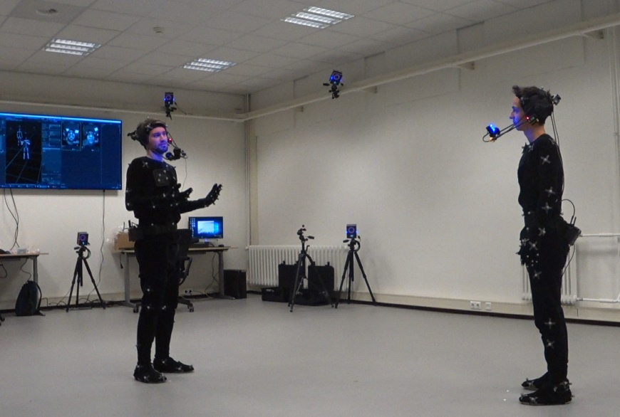
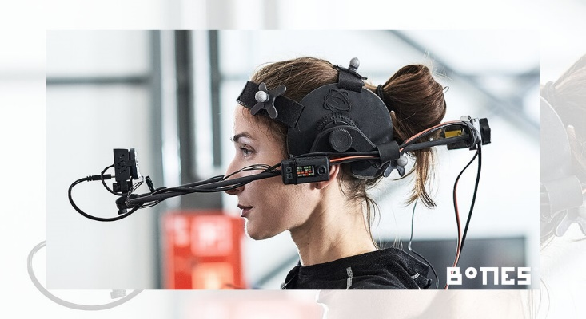
Motion Capture and Virtual Reality Lab
Full body motion capture equipment
  Multiple actors tracking including their facial expressions and finger movements
  50 m2 capture area
Vicon Optical Motion Capture System
  14 cameras
  Vicon Shogun (and Shogun Post) as software
Facial capture
  Dynamixyz & Faceware
    Single camera video-based system
    Software Performer, Grabber and Live Pro
    Software Analyzer and Retargeter
  iPhone and MetaHuman Animator
Two high-performance PCs
  One for Vicon and Dynamixyz tracking
  Another for post-processing (Motion Builder is installed)
Virtual Reality is also possible (not for this course)
  Vicon Pulsars and HP Reverb G2 headsets

Slide 15
Option 1: Animation movie
Evaluation criteria:
  Quality & complexity of animations (main criteria)
  Quality & complexity of rendering
  Story (engaging, entertaining..)
  Use of other supportive media (music, effects)
Upload intermediary deliverables by 24th Feb.
  Previz movie and a 1-page planning report
Presentation on 9th April. Upload final movie by 9th April 23:59!
  Movie and source project.

Slide 16
Option 2: Speech-driven facial animation using deep learning
Three parts:
  Reading and understanding the baseline model paper. Related papers will be covered during the course and in lecture “Advanced Facial Animation”.
  Propose, implement and train your own model.
  Evaluate your results against the provided baseline model. Three types of evaluations (the first two are mandatory):
    Quantitative/Objective Evaluation (with objective metrics)
    Qualitative/Subjective Evaluation (by producing video material showing the results, comparison to baseline)
    Perceptual User Study (that will result into bonus grade)

Slide 17
Option 2: Speech-driven facial animation using deep learning
Evaluation criteria:
  The quality of the research methodology and evaluation (the paper)
  Well-written and documented code
  Presentation/video demonstration
Upload intermediary deliverables by 24th Feb.
  2-page report describing the related work, potential direction regarding your deep learning model, planning of tasks and assignment of tasks to team members
Presentation including objective and subjective evaluation. Present it on 9th April. Upload your final material by 9th April 23:59!
  3-4 pages paper presenting the results, accompanying video, GitHub code with documentation

Slide 18
Essay
4-5 pages in double-column ACM Latex template
  https://www.acm.org/publications/proceedings-template
Can be on any topic related to animation
  Facial animation
  Motion synthesis
  Animation & emotions
  Expressive animations (gaze, gesture, speech)
  Locomotion
  Hand animation
  Skinning & Automatic Rigging
  Deep learning and animation

Slide 19
Essay
Choose three papers with different but related techniques
  You can use your presentation paper or any other paper from the paper set as one of the papers in your essay if you want
Describe the techniques in your essay, compare them in terms of pros and cons, show what the possible application areas are
Describe the techniques in enough depth
Write the essay in your own words!
You can start writing it anytime during the course. The earlier the better! Deadline 9th April until midnight!
  0-24 hours late: 1 point deduction
  24-48 hours late: 2 points deduction
  >48 hours late: submission rejected

Slide 20
Essay
Evaluation criteria
  depth and completeness of the description of the techniques,
  completeness of the comparison between techniques, including strengths and drawbacks,
  showing how the techniques can be applied,
  writing the essay in your own words, instead of copying phrases from the original papers,
  correct layout, spelling and grammar.

Slide 21
Retake
You can do a retake essay (only if you don’t get a passing grade)
  If you did all the assignments
  If your grade is at least 4
You may improve the essay you originally handed in, taking into account the feedback from the teacher
or choose a new topic and write an essay about that.

Slide 22
GenAI Usage
Use of Generative AI Tools such as ChatGPT and Co-Pilot for the production of assignments is not allowed and considered as fraud!
Basic usage such as grammar check or code auto-completion is allowed.
The usage should not interfere with the learning goals of the course. If not sure, please discuss with your teacher.

Slide 23
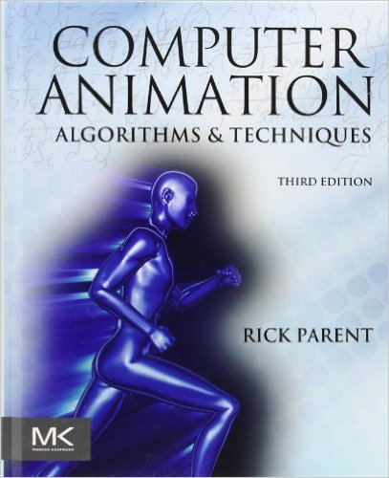
Supplementary Material
Computer Animation,
Rick Parent
Courses and tutorials at conferences (e.g. Siggraph and Eurographics)
Research papers
  See the course website (Assignments doc) for pointers to various conferences and journals

Slide 24
More info
Course website:
https://ics-websites.science.uu.nl/docs/vakken/mcanim
Schedule, Announcements, Assignment descriptions, Lecture slides, Previous years
BrightSpace: Assignment management (groups, uploads, feedback and grades)
MS Teams: Instant communication
Email: Individual contact

Slide 25
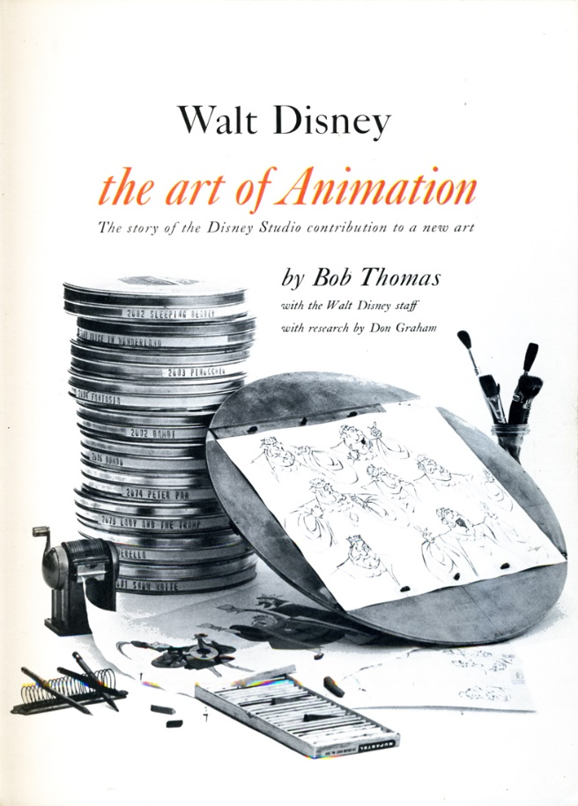

Animation
Animate means “to give life to” according to Merriam-Webster
Based on Latin word “anima”, meaning “breath” or “sprit”
  E.g. Animal
Animation is the process of making the illusion of motion and the illusion of change by means of the rapid display of a sequence of images that minimally differ from each other.
Pixar in a Box at Khan Academy - https://www.khanacademy.org/partner-content/pixar

Slide 26
Computer Animation
Computer-based computation used in producing images intended to create the perception of motion
  Algorithms and techniques that process 3D graphical data
Object’s position and orientation
  But also shape, shading parameters, texture coordinates, light source parameters, camera parameters

Slide 27
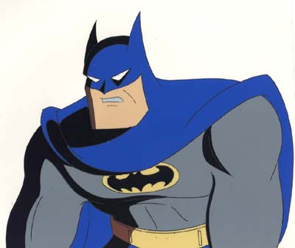
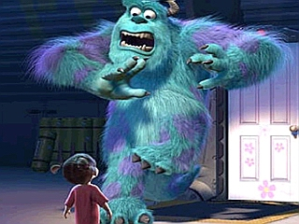
Two main categories
Computer-assisted animation
  2D & 2 1/2 D
  Inbetweening
  Inking, virtual camera, managing data, etc.
  Beauty and the Beast
Computer generated animation
  Low level techniques
    Precisely specifying motion
  High level techniques
    Describe general motion behavior
  Toy Story, Frozen, Inside Out, Shrek
Notes:
Computer-assisted vs computer-generated animation[edit]
To animate means "to give life to" and there are two basic ways that animators commonly do this.
Computer-assisted animation is usually classed as two-dimensional (2D) animation. Creators drawings either hand drawn (pencil to paper) or interactively drawn(drawn on the computer) using different assisting appliances and are positioned into specific software packages. Within the software package the creator will place drawings into different key frames which fundamentally create an outline of the most important movements. The computer will then fill in all the " in-between frames", commonly known as Tweening. Computer-assisted animation is basically using new technologies to cut down the time scale that traditional animation could take, but still having the elements of traditional drawings of characters or objects.^{[8]}
Two examples of films using computer-assisted animation are Beauty and the Beast and Antz.
Computer-generated animation is known as 3-dimensional (3D) animation. Creators will design an object or character with an X,Y and Z axis. Unlike the traditional way of animation no pencil to paper drawings create the way computer generated animation works. The object or character created will then be taken into a software, key framing and tweening are also carried out in computer generated animation but are also a lot of techniques used that do not relate to traditional animation. Animators can break physical laws by using mathematical algorithms to cheat, mass, force and gravity rulings. Fundamentally, time scale and quality could be said to be a preferred way to produce animation as they are two major things that are enhanced by using computer generated animation. Another great aspect of CGA is the fact you can create a flock of creatures to act independently when created as a group. An animal's fur can be programmed to wave in the wind and lie flat when it rains instead of programming each strand of hair separately.^{[8]}
A few examples of computer-generated animation movies are Toy Story, Frozen, Inside Out, Shrek, and Finding Nemo.
https://en.wikipedia.org/wiki/Computer_animation#Computer-assisted_vs_computer-generated_animation
2.5 D - http://www.explainervideoly.com/blog/difference-between-2d-2-5d-3d-animation/

Slide 28
Low level vs high level animation
Low-level techniques
  Shape interpolation
  Helps the animator fill in the details of the motion given enough information
  Animator has a fairly specific idea of target motion
High-level techniques
  Generate a motion given a set of rules or constraints
  Object motion is controlled by a model/algorithm
  Fairly sophisticated computation, such as physically-based motion

Slide 29
Example
Very low-level: animator colors every pixel individually in every frame
Very-high level: tell the computer “make a movie about a dog”
Challenge lies in developing tools that allow animators to animate on different levels

Slide 30
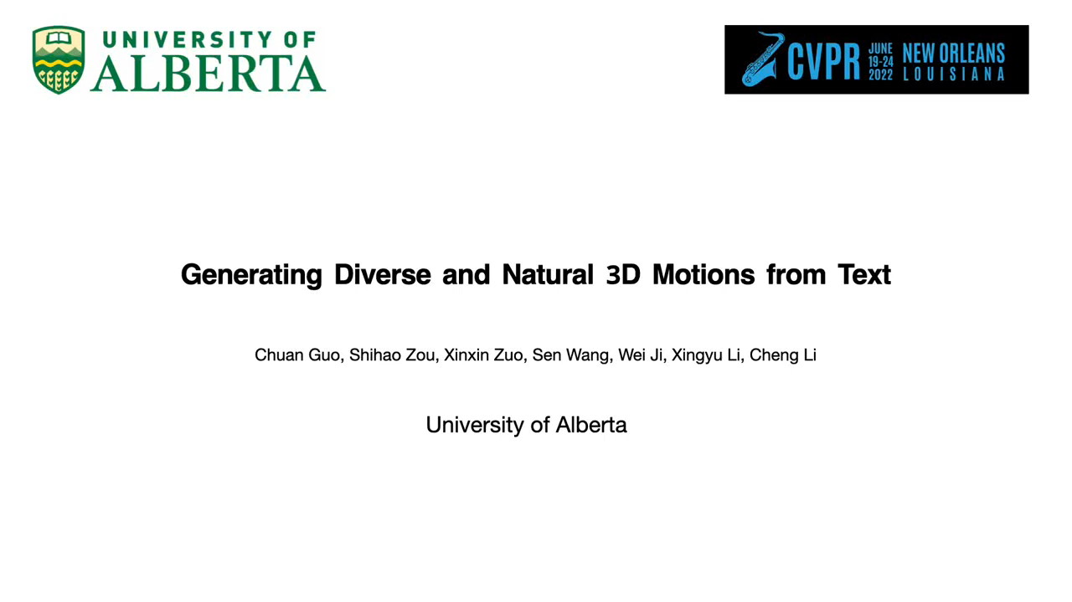

Slide 31
Applications
Special Effects/VFX (Movies, TV)
Video Games
Virtual Reality
Simulation, Training, Military
Medical
Robotics, Animatronics
Visualization
Communication

Slide 32
Three general approaches to computer animation
Artistic animation
  Animator crafts the motion
  Keyframing and interpolation
Data-driven animation
  Digitizing live motion and applying to 3D objects
  Motion capture
  AI-driven animation (speech-driven, text-driven)
Procedural animation
  Computational models of motion
  By setting initial conditions for physical and behavioral simulation

Slide 33
Animation Tools
Animation tools:
  Maya
  3D Studio Max
  MotionBuilder
  Blender
Game/graphics engines:
  OGRE3D
  Unity
  Unreal
Open source skeletal animation library:
  Cal3D
  Smartbody
3D graphics programming:
  OpenGL
  DirectX
  Vulkan

Slide 34
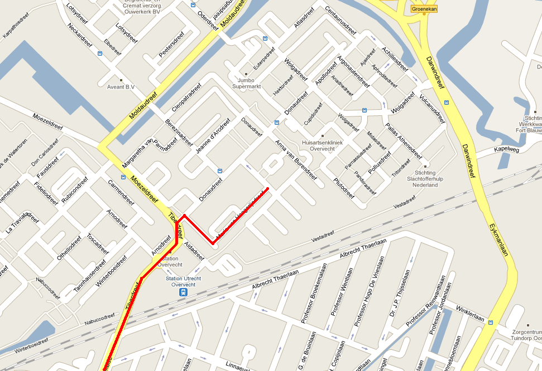
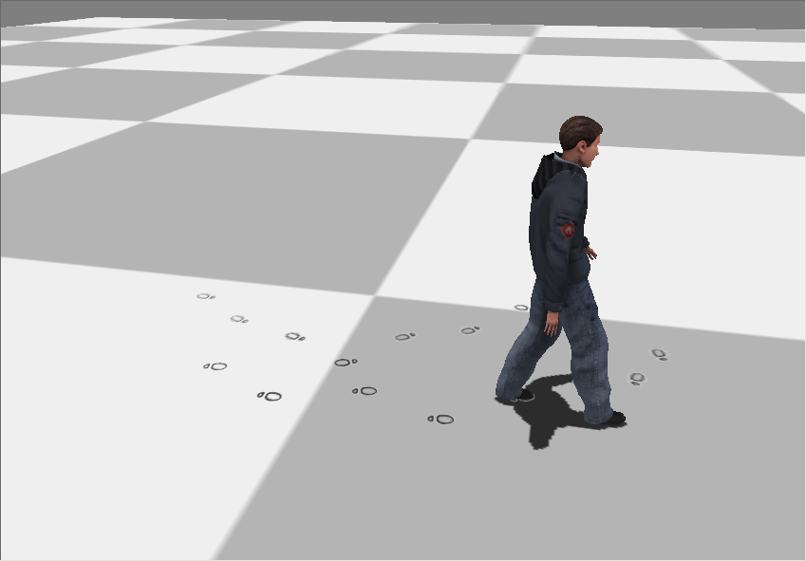
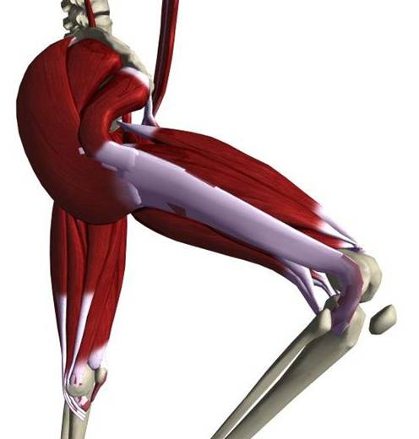
Virtual Characters
Different levels of character motion

Slide 35
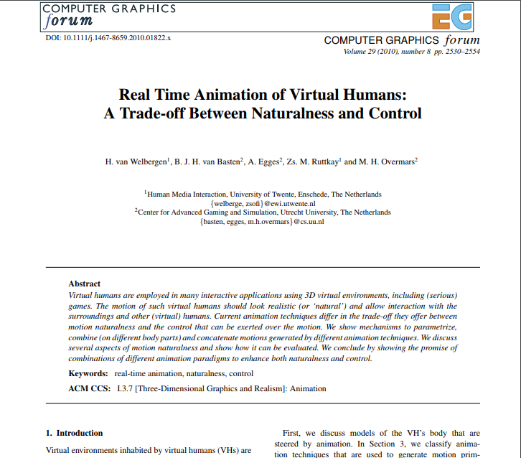

Slide 36
History of Computer Animation

Slide 37
Perception
Eye/brain assembles images and interprets them as continuous movement
Persistence of vision: sequence of still images shown at a fast enough rate to induce sensation of continuous imagery
Eye retains visual imprint once stimulus is removed
  “positive afterimages”
Notes:
https://www.youtube.com/watch?v=YeRbwhfaHfQ (Motion picture 1936)
Persistence of vision/motion: rotating a white light source fast enough will create impression of stationary white ring. This is due to persistence of vision, but result is static.
https://en.wikipedia.org/wiki/Persistence_of_vision
https://en.wikipedia.org/wiki/Afterimage
http://sciphile.org/lessons/positive-afterimages
Animations are usually a series of still images displayed as a rapid sequence
positive afterimage is a copy in the visual system of an image shown quickly, e.g., the flash of a camera
persistence of vision is the sensation of continuous imagery produced by individual images being shown quickly (at least quick enough)
It is widely recognized that a series of images, when displayed in rapid succession, are perceived by an observer as a single moving image. This is possible because the eye–brain complex has the ability, under sufficient viewing conditions and within certain playback rates, to create a sensation of contin- uous imagery from such a sequence of still images. A commonly held view is that this experience is due to persistence of vision, whereby the eye retains a visual imprint of an image for a brief instant once the stimulus is removed. It is argued that these imprints, called positive afterimages of the individual stills, fill in the gaps between the images to produce the perception of a continuously changing image.

Slide 38
Perception
Flicker: the image flickers when persistence of vision does not occur
  When the perception of continuous imagery fails to be created, the display is said to flicker.
Critical flicker frequency is the rate at which the images must be shown in order to maintain persistence of vision.
  Different things that affect it are: room lighting, viewing distance, etc. The critical flicker frequency determines the lower bound on the playback rate.
Notes:
http://www2.cs.uregina.ca/~anima/408/Notes/Intro/Intro.htm
https://www.cs.purdue.edu/homes/aliaga/cs334-13fall/lectures/lec-animation.pdf
flicker: the image flickers when persistence of vision does not occur
critical flicker frequency (called the flicker rate in Parent, 1st edition) is the rate at which the images must be shown in order to maintain persistence of vision. Different things that affect it are: room lighting, viewing distance, etc. The critical flicker frequency determines the lower bound on the playback rate.
persistence of motion is the sensation that something is moving. It is not the same as the persistence of vision. Motion is perceived but not necessarily due to a succession of still images, e.g., lights on a movie marquee
motion blur results when still images are displayed too quickly (upper bound)
- occurs with a still camera if the shutter speed is too slow
- occurs in film if an object’s speed is too high compared to sampling interval
- never occurs in computer animation unless the scene is sampled over an interval of time and not at a precise moment in time
- motion blur can be calculated and added to animation (See Appendix A of Parent’s book) to prevent strobing (choppiness)
playback rate (refresh rate): number of images displayed per second
- determines whether or not flickering occurs
sampling rate (update rate): number of distinct images that occur per second (see appendix B)
- determines whether or not strobing occurs
Example: cheap cartoons have a sampling rate of 6 frames per second (fps) but each image is repeated five times, so the playback rate is 30 fps.

Slide 39
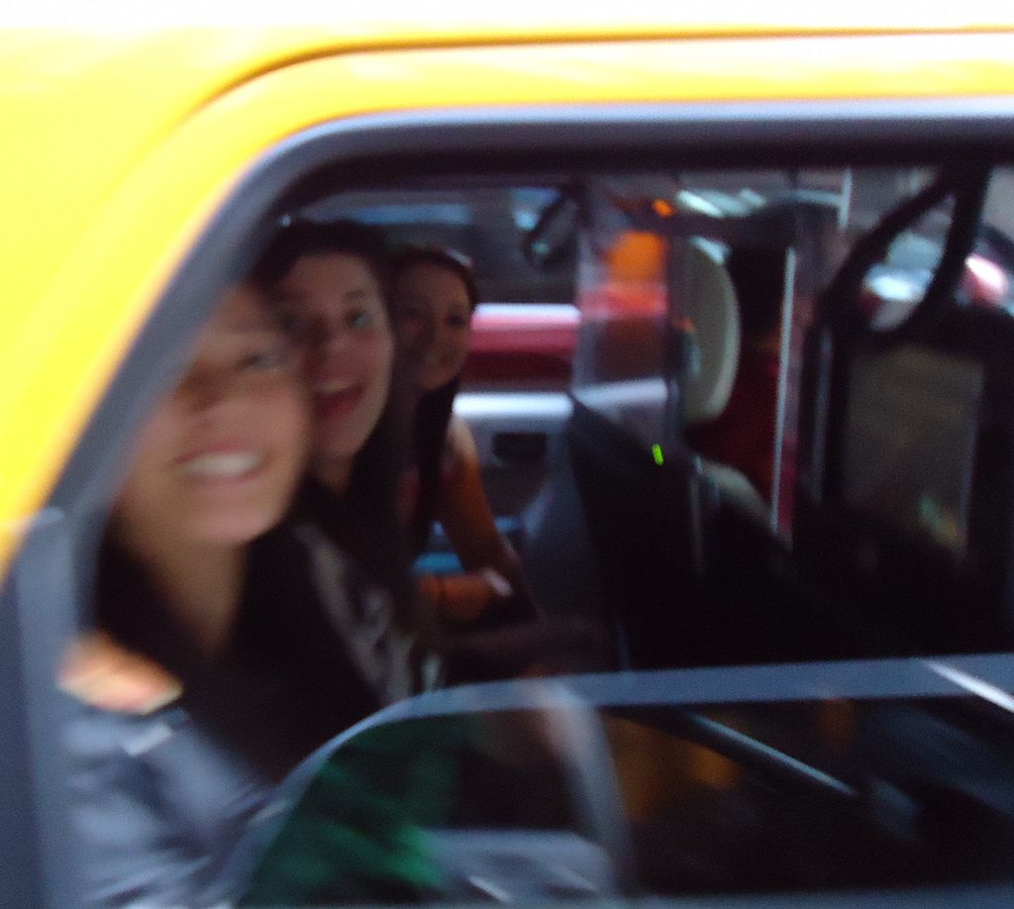
Perception
Lower bound:
  Critical flicker frequency: lower limits for establishing the perception of continuous imagery
  Playback/refresh rate: number of images displayed per second
Upper bound:
  Upper limits the eye can perceive motion, if an object moves too quickly
  Motion blur: the receptors in the eye will not be able to respond fast enough for the brain to distinguish sharply defined, individual detail and motion blur occurs.

Slide 40
Perception
Two important rates:
  Playback/refresh rate: number of images displayed per second
    Related to flicker
  Sampling/update rate: number of distinct images that occur per second
    How jerky the motion will appear
  e.g. Saturday morning cartoons have a sampling rate of 6 frames per second (fps) but each image is repeated five times, so the playback rate is 30 fps.
Notes:
History of frame rate: https://www.youtube.com/watch?v=mjYjFEp9Yx0

Slide 41
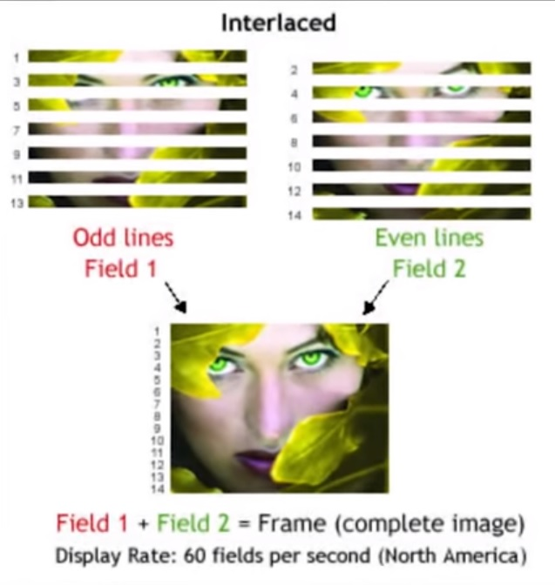
Frame Rates
Film 24 fps
Imax 48 fps
NTSC TV 30 fps (interlaced)
PAL TV 25 fps (interlaced)
HDTV 50-60 fps
Computer >60 fps
History of frame rate: https://www.youtube.com/watch?v=mjYjFEp9Yx0
Notes:
National Television System Committee
Phase Alternating Line

Slide 42
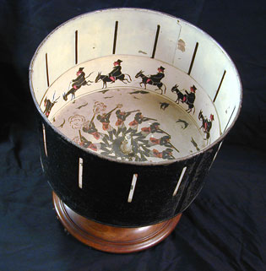
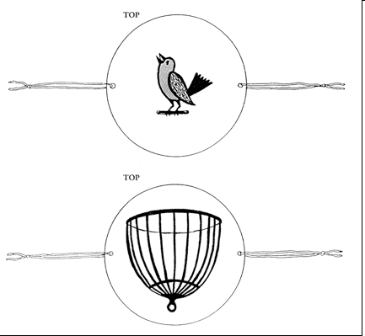
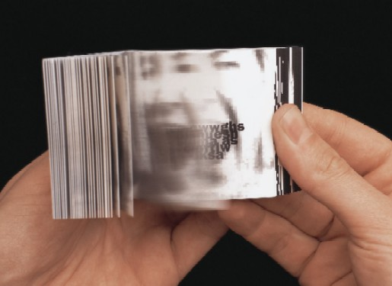
The early days
Persistence of vision: discovered in the 1800s.
  Zoetrope
  Flipbook
  Thaumatrope

Slide 43
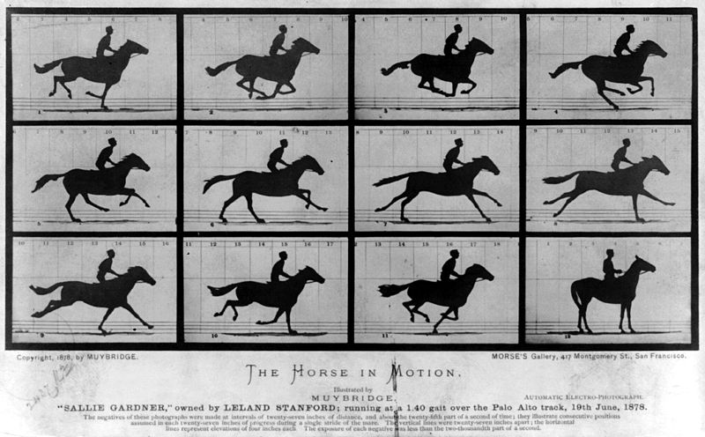
Muybridge 1899
Notes:
As the story goes, in 1872 railroad magnate and ex-governor of California Leland Stanford made a bet with a fellow horseman regarding a horse's gallop. Contending that all four of a horse's feet are off the ground simultaneously at some point while galloping, Stanford hired Muybridge to prove it photographically.
Muybridge's first photographs of the horse were poorly exposed and thus inconclusive. After constructing a more efficient shutter and improving the speed of his film, he resumed his experiments with motion studies in 1877, but he was still producing only single images. Undaunted, he developed a system of first twelve and eventually twenty-four cameras, whose electro-magnetic shutter blades were opened by the stride of the animal tripping wires strung across the track. This series of twenty-four consecutive frames, which took less than one second to expose, was made after Muybridge had perfected his technique. Ultimately, Muybridge did prove that all four feet of a galloping horse were off the ground simultaneously.
http://www.getty.edu/azrt/collection/objects/98970/eadweard-j-muybridge-running-galloping-american-1878-1879/
https://vimeo.com/13883000

Slide 44
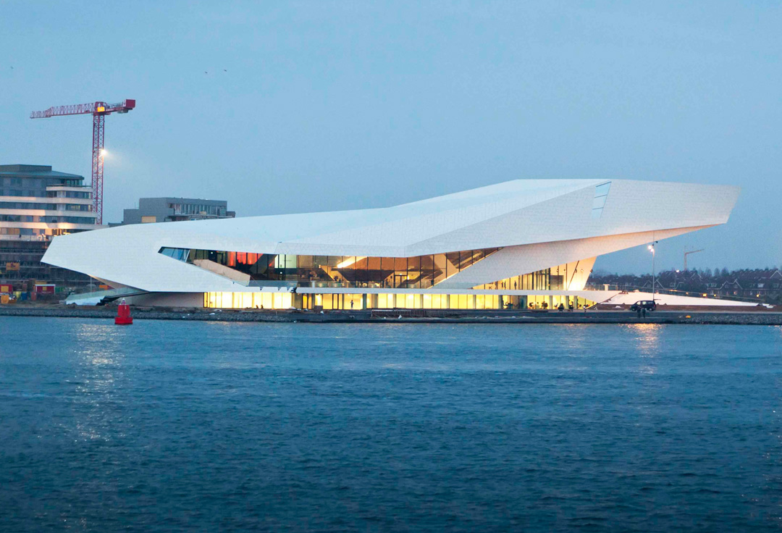
Eye Museum, Amsterdam

Slide 45
Computer Animation Production
Conceptual Design
Production Design
Modeling
Materials & Shaders
Rigging
Blocking
Animation
Lighting
Effects
Rendering
Post-Production

Slide 46
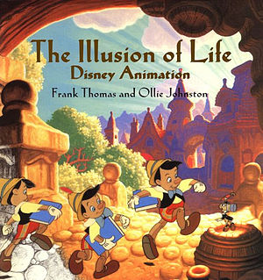
12 Principles of Animation
John Lasseter, "Principles of Traditional Animation Applied to 3D Computer Animation", Computer Graphics, pp. 35-44, 21:4, July 1987 (SIGGRAPH 87).
http://www.hao-li.com/cs420-fs2017/slides/Lecture11.1.pdf

Slide 47
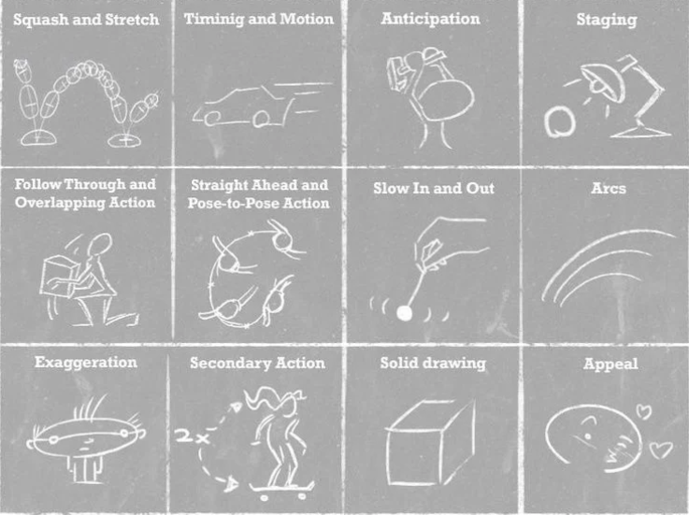
12 Principles of Animation
Squash and Stretch - defining the rigidity and mass of an object by distorting its shape during an action
Timing and Motion - spacing actions to define the weight and size of objects and the personality of characters
Anticipation - the preparation for an action
Follow Through and Overlapping Action - the termination of an action and establishing its relationship to the next action
Slow In and Out - the spacing of the in-between frames to achieve subtlety of timing and movement
Arcs - the visual path of action for natural movement
Exaggeration - Accentuating the essence of an idea via the design and the action
Secondary Action - the action of an object resulting from another action
…
https://www.youtube.com/watch?v=uDqjIdI4bF4&ab_channel=AlanBeckerTutorials
Notes:
Video: https://www.youtube.com/watch?v=uDqjIdI4bF4&ab_channel=AlanBeckerTutorials

Slide 48



Computer Animation as Animation
Lasseter translated traditional principles of animation to computer animation (1980s)
  Lasseter is conventionally trained animator
    Worked at Disney before going to Pixar
      Chief creative officer Pixar
    Many animation films
      Toy story, Wall-e, Frozen, Inside Out
Notes:
John Lasseter - Chief creative officer Pixar
Toy story
Wall-e
Ratatouille
Frozen
Inside Out
Luxo Jr. - https://www.youtube.com/watch?v=wYfYtV_2ezs (lamp)
Knick-knack - https://www.youtube.com/watch?v=GTIj5s-N0eM (snow men)
Tin-toy - first CGI film to win an Oscar 1988 - https://www.youtube.com/watch?v=wtFYP4t9TG0 – beginning of toy story

Slide 49
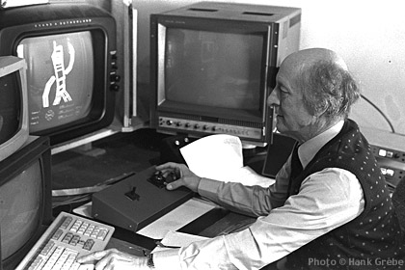
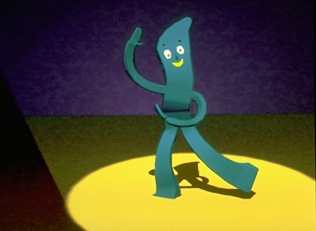
Computer Animation Research
In Research labs (from 1970s)
New York Institute of Technology (NYIT)
  Gumby (Presented at SIGGRAPH '84 & '85 Electronic Theatres)
Still frame from Gumby animation by Hank Grebe and Dick Lundin, 1984.
Notes:
Pioneer New York Institute of Technology
Ed Catmull and others: President of Pixar and Walt Disney Animation Studios
Gumby 3D Computer Animation
Modeled, animated and rendered at NYIT Computer Graphics Lab.
In this 3D geometric world, Gumby is made of polygons, not green clay.
Hand model from Catmull data set, flex software by R. Lundin, with joints added by H. Grebe.
Presented at SIGGRAPH '84 & '85 Electronic Theatres.

Slide 50
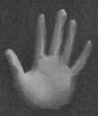
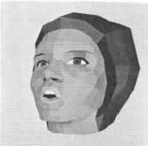

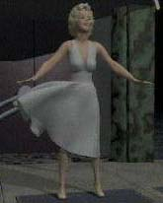
Computer Animation Research
University of Utah
  Films on walking and talking figure
  Animated hand and animated face (Ed Catmull (president of Pixar), 1972) (Fred Parke, Talking face, 1974)
University of Pennsylvania
  Human figure animation (Norm Badler, 1975)
MIRALab, Geneva
  Virtual Humans (Daniel & Nadia Thalmann, 1980s)
Notes:
Utah – Fred Parke https://www.youtube.com/watch?v=SPMFhcC4SvQ
http://www.pixartouchbook.com/blog/tag/early-computer-animation
http://boingboing.net/2015/08/05/watch-breakthrough-computer-an.html
Thalmanns - https://www.youtube.com/watch?v=m5kVMn_wR2g

Slide 51
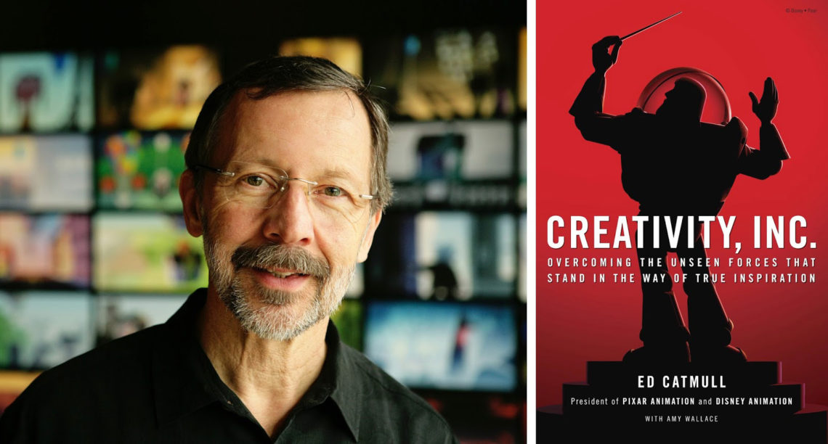
Computer Animation Research
Ed Catmull: Co-founder of Pixar and was president of Walt Disney Animation Studios

Slide 52
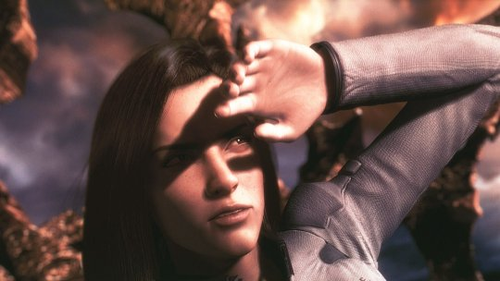
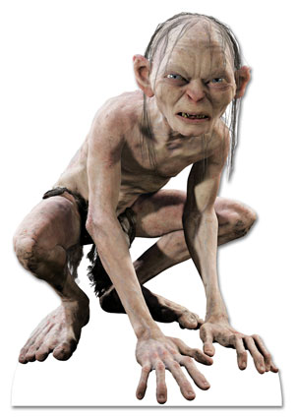
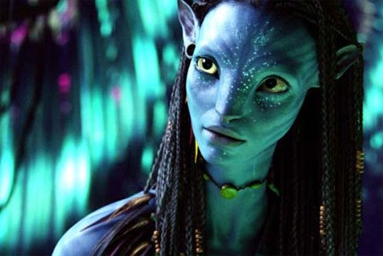
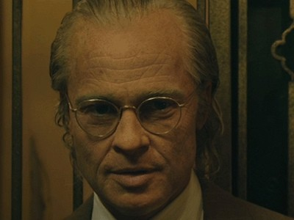
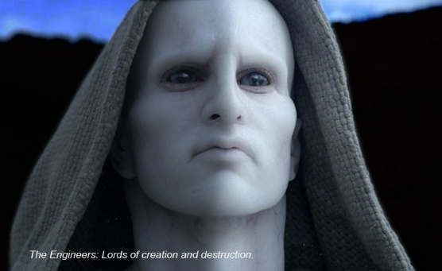
More recent movies with CG
Final fantasy (2001)
  Fully 3D simulated environment
Lord of the Rings (2001-2003)
  One of the first movies using crowds (Massive)
Avatar (2009)
Benjamin Button (2008)
Prometheus (2012)

Slide 53
Animation Basics

Slide 54
Position Vector Dot Matrix

Slide 55
Position Vector Dot Matrix
y
v=(.5,.5,0,1)
x
(0,0,0)
Local Space

Slide 56
Position Vector Dot Matrix
b
Matrix M
y
y
d
a
v=(.5,.5,0,1)
x
x
(0,0,0)
(0,0,0)
Local Space
World Space

Slide 57
Position Vector Dot Matrix
b
v’
y
y
d
a
v=(.5,.5,0,1)
x
x
(0,0,0)
(0,0,0)
Local Space
World Space

Slide 58
Direction Vector Dot Matrix

Slide 59
Transformations
To transform a vector v by matrix M:
v’=v·M
If we want to apply several transformations, we can just multiply by several matrices:
v’=(((v·M₁)·M₂)·M₃)·M₄…
Or we can concatenate the transformations into a single matrix:
M_{total}=M₁·M₂·M₃·M₄…
v’=v·M_{total}

Slide 60
Inversion
If M transforms v into world space, then M⁻¹ transforms v’ back into local space

Slide 61
Matrix Transformations
We usually transform vertices from some local space where they are defined into a world space
v’ = v·W
Once in world space, we can perform operations that require everything to be in the same space (collision detection, high quality lighting…)
Then, they are transformed into a camera’s space, and then projected into 2D
v’’ = v’·C⁻¹·P
In simple situations, we can do this all in one step:
v’’ = v·W·C⁻¹·P
Notes:
The world-to-camera transformation matrix is the inverse of the camera-to-world matrix.

Slide 62
(Forward) Kinematics

Slide 63
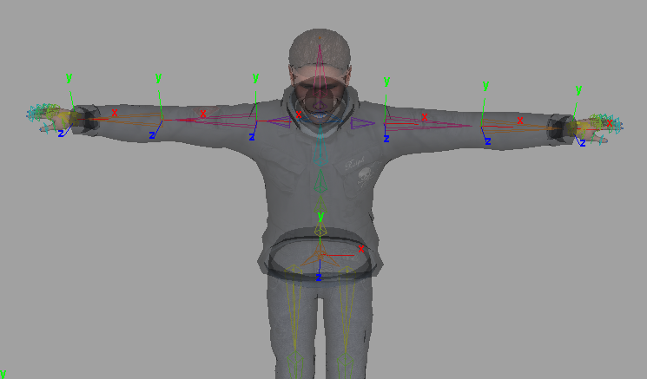
Virtual Characters
Representation: skeletal model
  A VH is represented by a polyhedral model (or mesh)
  An underlying skeleton deforms this mesh
    Joints, connected by bones
  A pose is defined by the rotations of the joints and the position of the root joint

Slide 64
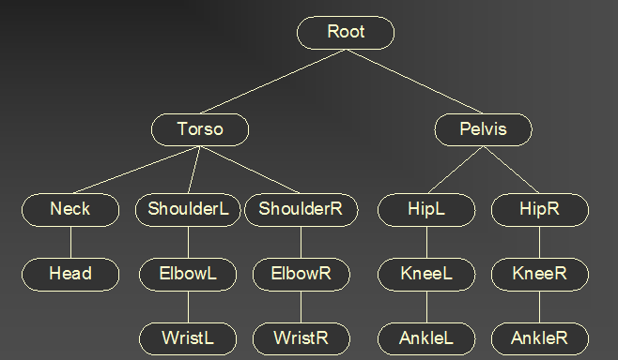
Example Joint Hierarchy

Slide 65
DOFs
Degree of Freedom (DOF)
  A variable φ describing a particular axis or dimension of movement within a joint
Joints typically have around 1-6 DOFs (φ₁…φ_{N})
Changing the DOF values over time results in the animation of the skeleton
Note: in a mathematical sense, a free rigid body has 6 DOFs: 3 for position and 3 for rotation

Slide 66
Kinematics
Kinematics
  The analysis of motion independent of physical forces. Kinematics deals with position, velocity, acceleration, and their rotational counterparts, orientation, angular velocity, and angular acceleration.
Forward Kinematics
  The process of computing world space geometric data from DOFs
Inverse Kinematics
  The process of computing a set of DOFs that causes some world space goal to be met (I.e., place the hand on the door knob…)

Slide 67
Skeletons
Skeleton
  A pose-able framework of joints arranged in a tree structure.
Joint
  Allows relative movement within the skeleton.
  Are essentially 4x4 matrix transformations
  Can be rotational, translational, or other
  Synonym: bone, armature

Slide 68
Joints
Core Joint Data
  DOFs (N floats)
  Local matrix: L
  World matrix: W
Additional Data
  Joint offset vector: r
  DOF limits (min & max value per DOF)
  Tree data (pointers to children, siblings, parent…)

Slide 69
Skeleton Posing Process
Specify all DOF values for the skeleton (done by higher level animation system)
Recursively traverse through the hierarchy starting at the root and use forward kinematics to compute the world matrices (done by skeleton system)
Use world matrices to deform skin & render (done by skinning system)
Note: the matrices can also be used for other things such as collision detection, FX, etc.

Slide 70
Forward Kinematics
In the recursive tree traversal, each joint first computes its local matrix L based on the values of its DOFs and some formula representative of the joint type:
  Local matrix L = L_{joint}(φ₁,φ₂,…,φ_{N})
Then, world matrix W is computed by concatenating L with the world matrix of the parent joint
  World matrix W = L · W_{parent}
Notes:
Forward Kinematics vs. Inverse Kinematics Concept in 3 minutes- https://www.youtube.com/watch?v=b1arysUSlzo&ab_channel=ThreeDee

Slide 71
Joint Offsets
It is convenient to have a 3D offset vector r for every joint which represents its pivot point relative to its parent’s matrix

Slide 72
DOF Limits
It is nice to be able to limit a DOF to some range (for example, the elbow could be limited from 0º to 150º)
Usually, in a realistic character, all DOFs will be limited except the ones controlling the root

Slide 73
Poses
One can then adjust each of the DOFs to specify the pose of the skeleton
We can define a pose Φ more formally as a vector of N numbers that maps to a set of DOFs in the skeleton
Φ = [φ₁ φ₂ … φ_{N}]
A pose is a convenient unit that can be manipulated by a higher level animation system and then handed down to the skeleton
Usually, each joint will have around 1-6 DOFs, but an entire character might have 100+ DOFs in the skeleton

Slide 74
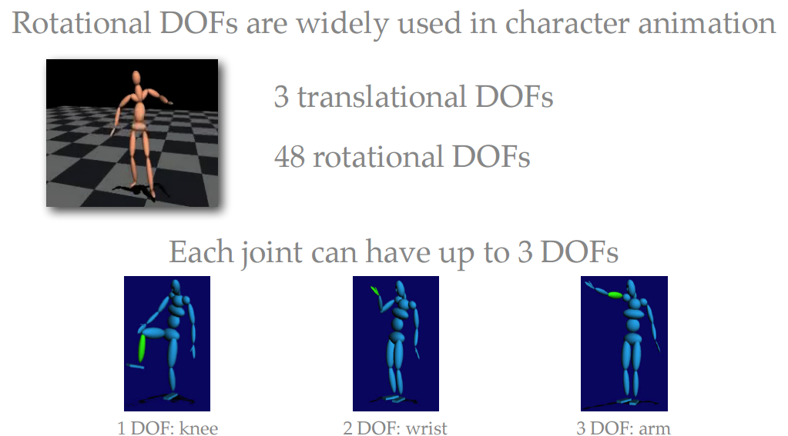
Joints and rotations

Slide 75
Joint Types
Rotational
  Hinge: 1-DOF
  Universal: 2-DOF
  Ball & Socket: 3-DOF
    Euler Angles
    Quaternions
Translational
  Prismatic: 1-DOF
  Translational: 3-DOF (or any number)

Slide 76
Hinge Joints (1-DOF Rotational)
Rotation around the x-axis:

Slide 77
Hinge Joints (1-DOF Rotational)
Rotation around the y-axis:

Slide 78
Hinge Joints (1-DOF Rotational)
Rotation around the z-axis:

Slide 79
Universal Joints (2-DOF)
For a 2-DOF joint that first rotates around x and then around y:

Slide 80
Ball & Socket (3-DOF)
For a 3-DOF joint that first rotates around x, y, then z:
Different matrices can be formed for different axis combinations

Slide 81
Prismatic Joints (1-DOF Translation)
1-DOF translation along an arbitrary axis a:

Slide 82
Translational Joints (3-DOF)
For a more general 3-DOF translation:
Notes:
Additional reading resource- https://cseweb.ucsd.edu/classes/wi20/cse169-a/readings/2-Skeleton.html

Slide 83
Orientation

Slide 84
Orientation
We will define ‘orientation’ to mean an object’s instantaneous rotational configuration
Think of it as the rotational equivalent of position

Slide 85
Representing Orientations
Is there a simple means of representing a 3D orientation? (analogous to Cartesian coordinates?)
Not really.
There are several popular options though:
  3x3 matrices
  Fixed/Euler angles
  Rotation vectors (axis/angle)
  Quaternions
  and more…

Slide 86
Euler Angles
This means that we can represent an orientation with 3 numbers
A sequence of rotations around principal axes is called an Euler Angle Sequence
Assuming we limit ourselves to 3 rotations without successive rotations about the same axis, we could use any of the following 12 sequences:
XYZ XZY XYX XZX
YXZ YZX YXY YZY
ZXY ZYX ZXZ ZYZ

Slide 87
Euler Angles to Matrix Conversion
To build a matrix from a set of Euler angles, we just multiply a sequence of rotation matrices together:

Slide 88
Euler Angle Order
As matrix multiplication is not commutative, the order of operations is important
Rotations are assumed to be relative to fixed world axes or local to the object

Slide 89
Euler Angles
They can suffer from Gimbal lock and related problems
They do not interpolate in a consistent way
There is no simple way to concatenate rotations
Conversion to/from a matrix requires several trigonometry operations
They are compact (requiring only 3 numbers)

Slide 90
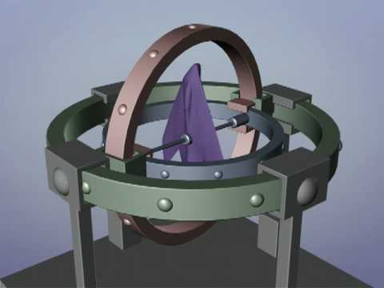
Gimbal Lock
One potential problem that they can suffer from is ‘gimbal lock’
This results when two axes effectively line up, resulting in a temporary loss of a degree of freedom
https://www.youtube.com/watch?v=zc8b2Jo7mno
Notes:
https://www.youtube.com/watch?v=zc8b2Jo7mno

Slide 91
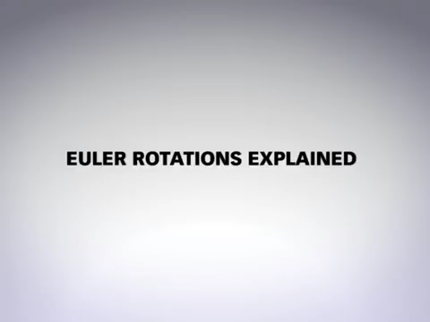

Slide 92
Matrix Representation
We use a 3x3 matrix to represent an orientation as well
This means we now have 9 numbers instead of 3, and therefore, we have 6 extra degrees of freedom
NOTE: We don’t use 4x4 matrices here, as those are mainly useful because they give us the ability to combine translations. We will not be concerned with translation, so we will just think of 3x3 matrices.

Slide 93
Matrix Representation
Matrices are usually the most computationally efficient way to apply rotations to geometric data, and so most orientation representations ultimately need to be converted into a matrix in order to do anything useful (transform verts…)
Why then, shouldn’t we just always use matrices?
  Numerical issues
  Storage issues
  User interaction issues
  Interpolation issues
Notes:
https://www.youtube.com/watch?v=Mm8tzzfy1Uw

Slide 94
Rotation Vectors and Axis/Angle
Any two orientations can be related by a single rotation about some axis (not necessarily a principal axis)
This means that we can represent an arbitrary orientation as a rotation about some unit axis by some angle (4 numbers) (Axis/Angle form)
Alternately, we can scale the axis by the angle and compact it down to a single 3D vector
  rotation vector or exponential map

Slide 95
Axis/Angle to Matrix
To generate a matrix as a rotation θ around an arbitrary unit axis a:

Slide 96
Quaternions

Slide 97
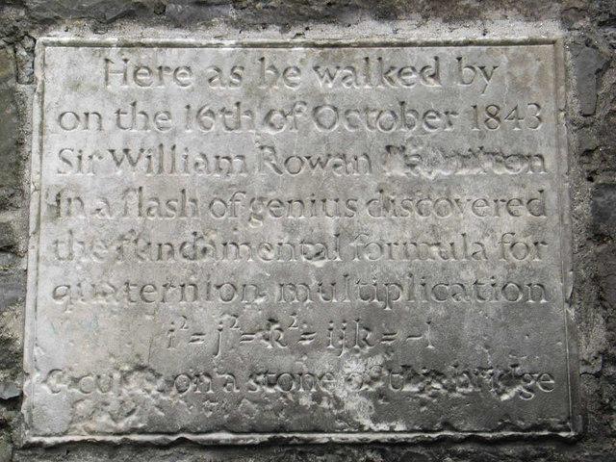
Quaternions
Quaternions are an interesting mathematical concept with a deep relationship with the foundations of algebra and number theory
Invented by W.R.Hamilton in 1843
In practice, they are most useful to us as a means of representing orientations
A quaternion has 4 components

Slide 98
Quaternions (Imaginary Space)
Quaternions are actually an extension to complex numbers
Of the 4 components, one is a ‘real’ scalar number, and the other 3 form a vector in imaginary ijk space!

Slide 99
Quaternions (Scalar/Vector)
Sometimes, they are written as the combination of a scalar value s and a vector value v
where

Slide 100
Unit Quaternions
For convenience, we will use only unit length quaternions, as they will be sufficient for our purposes and make things a little easier
These correspond to the set of vectors that form the ‘surface’ of a 4D hypersphere of radius 1
The ‘surface’ is actually a 3D volume in 4D space, but it can be visualized as an extension to the concept of a 2D surface on a 3D sphere

Slide 101
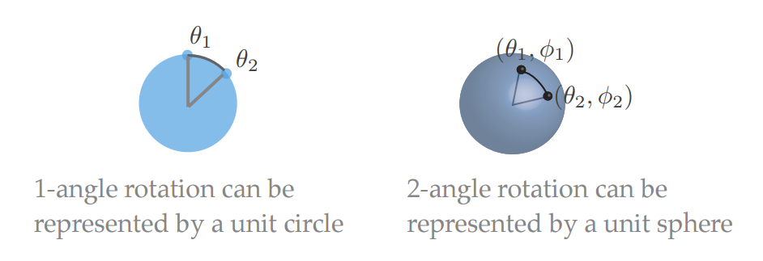
Visualizing quaternions
What about 3-angle rotation?
A unit quaternion is a point on the 4D sphere

Slide 102
Quaternions as Rotations
A quaternion can represent a rotation by an angle θ around a unit axis a:
If a is unit length, then q will be also

Slide 103
Quaternions as Rotations

Slide 104
Quaternion to Matrix
To convert a quaternion to a rotation matrix:

Slide 105
Matrix to Quaternion
Matrix to quaternion is not too bad, I just don’t have room for it here
It involves a few ‘if’ statements, a square root, three divisions, and some other stuff
For the algorithm, see:
http://www.euclideanspace.com/maths/geometry/rotations/conversions/matrixToQuaternion/index.htm

Slide 106
Spheres
Think of a person standing on the surface of a big sphere (like a planet)
From the person’s point of view, they can move in along two orthogonal axes (front/back) and (left/right)
There is no perception of any fixed poles or longitude/latitude, because no matter which direction they face, they always have two orthogonal ways to go
From their point of view, they might as well be moving on a infinite 2D plane, however if they go too far in one direction, they will come back to where they started!

Slide 107
Hyperspheres
Now extend this concept to moving in the hypersphere of unit quaternions
The person now has three orthogonal directions to go
No matter how they are oriented in this space, they can always go some combination of forward/backward, left/right and up/down
If they go too far in any one direction, they will come back to where they started

Slide 108
Hyperspheres
Now consider that a person’s location on this hypersphere represents an orientation
Any incremental movement along one of the orthogonal axes in curved space corresponds to an incremental rotation along an axis in real space (distances along the hypersphere correspond to angles in 3D space)
Moving in some arbitrary direction corresponds to rotating around some arbitrary axis
If you move too far in one direction, you come back to where you started (corresponding to rotating 360 degrees around any one axis)

Slide 109
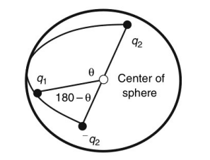
Hyperspheres
A distance of x along the surface of the hypersphere corresponds to a rotation of angle 2x radians
This means that moving along a 90 degree arc on the hypersphere corresponds to rotating an object by 180 degrees
Traveling 180 degrees corresponds to a 360 degree rotation, thus getting you back to where you started
This implies that q and -q correspond to the same orientation

Slide 110
Hyperspheres
Consider what happens if you rotate a book 180 around x, then 180 around y, and then 180 around z
You end up back where you started
This corresponds to traveling along a triangle on the hypersphere where each edge is a 90 degree arc, orthogonal to each other edge

Slide 111
Quaternion Joints
One can create a skeleton using quaternion joints
One possibility is to simply allow a quaternion joint type and provide a local matrix function that takes a quaternion
Another possibility is to also compute the world matrices as quaternion multiplications. This involves a little less math than matrices, but may not prove to be significantly faster. Also, one would still have to handle the joint offsets with matrix math

Slide 112
Quaternions in the Pose Vector
Using quaternions in the skeleton adds some complications, as they can’t simply be treated as 4 independent DOFs through the rig
The reason is that the 4 numbers are not independent, and so an animation system would have to handle them specifically as a quaternion
To deal with this, one might have to extend the concept of the pose vector as containing an array of scalars and an array of quaternions
When higher level animation code blends and manipulates poses, it will have to treat quaternions specially

Slide 113
Quaternion Interpolation

Slide 114
Linear Interpolation
If we want to do a linear interpolation between two points a and b in normal space
Lerp(t,a,b) = (1-t)a + (t)b
where t ranges from 0 to 1
Note that the Lerp operation can be thought of as a weighted average
We could also write it in its additive blend form:
Lerp(t,a,b) = a + t(b-a)

Slide 115
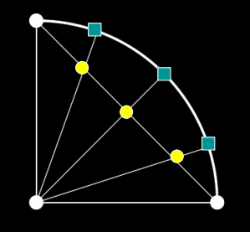
Spherical Linear Interpolation
If we want to interpolate between two points on a sphere (or hypersphere), we don’t just want to Lerp between them
Instead, we will travel across the surface of the sphere by following a ‘great arc’

Slide 116
Spherical Linear Interpolation
We define the spherical linear interpolation of two unit vectors in N dimensional space as:

Slide 117
Quaternion Interpolation
Remember that there are two redundant vectors in quaternion space for every unique orientation in 3D space
What is the difference between:
Slerp(t,a,b) and Slerp(t,-a,b) ?
One of these will travel less than 90 degrees while the other will travel more than 90 degrees across the sphere
This corresponds to rotating the ‘short way’ or the ‘long way’
Usually, we want to take the short way, so we negate one of them if their dot product is < 0 (angle greater than 90 degrees)

Slide 118
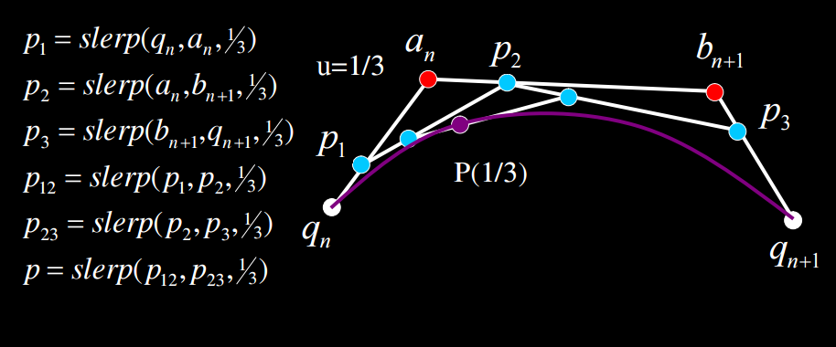
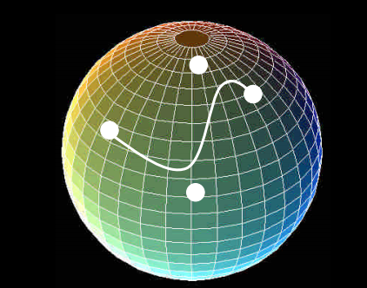
Bezier Curves in Quaternion Space
We can construct Bezier curves on the 4D hypersphere by following the exact same procedure using Slerp instead of Lerp
It’s a good idea to flip (negate) the input quaternions as necessary in order to make it go the ‘short way’

Slide 119
Quaternion Summary
Quaternions are 4D vectors that can represent 3D rigid body orientations
We choose to force them to be unit length
Key animation functions:
  Quaternion-to-matrix / matrix-to-quaternion
  Quaternion multiplication: faster than matrix multiplication
  Slerp: interpolate between arbitrary orientations
  Spherical curves: de Castlejau algorithm for cubic Bezier curves on the hypersphere
More quaternions: https://eater.net/quaternions

Slide 120
Comparison of representations
For animation input: Euler angles
Setting joint limits: Euler angles, axis angle
Good interpolation: Axis angle and quaternions
Good composition: Quaternions and orientation matrix
Rendering: Orientation matrix

Slide 121
References
Rick Parent book Chapter 1,2 and 3
https://en.wikipedia.org/wiki/Quaternions_and_spatial_rotation
“Animating Rotation with Quaternion Curves”, Ken Shoemake, SIGGRAPH 1985
Computer Animation course at the University of California San Diego.

Slide 122
What to do after this lecture
Make paper presentation groups of 2 on BrightSpace and select your paper (23 papers are provided).
  The time slot of the paper can be found on the course schedule on the course website
    e.g. Paper 1 is presented on 26th Feb
Make project groups of 5 on BrightSpace
In case of questions write a post on the corresponding channel on Teams.
Deadline: 10th February Tuesday 23:59

Slide 123
Next Lecture
  5th February 13:15
  Interpolation & Blending

